Slide 1
Developing XBlocks @ UPValencia
Carlos Turro (turro@cc.upv.es)
Leonardo Salom (leosamu@upv.es)

Slide 2
What?
Small Python plugins that can be added to Open edX easily
Fancier than write HTML code
More capable than just writing HTML code
List of available Open edX XBlocks at https://github.com/edx/edx-platform/wiki/List-of-XBlocks
If you want to know more about Xblocks take a look to Xavier Antoniaque’s tutorial

Slide 3
Why?
<object data="{self.href}" type="application/pdf" width="100%" height="500">
<p>It appears you don't have a PDF plugin for this browser.
You can <a href="{self.href}">click here to
download the PDF file.</a></p>
</object>

Slide 4
Why?
<object data="{self.href}" type="application/pdf" width="100%" height="500">
<p>It appears you don't have a PDF plugin for this browser.
You can <a href="{self.href}">click here to
download the PDF file.</a></p>
</object>

Slide 5
Why?

Slide 6
Three interaction levels
Storage
Store content & user input
Template
Ease Management
Interaction with the platform & other XBlocks
Interaction

Slide 7
Three interaction levels
Storage
CDF (Mathematica) viewer
Template
PDF viewer
Paella Player (Dual Video viewer)
Interaction
Multitab viewer

Slide 8
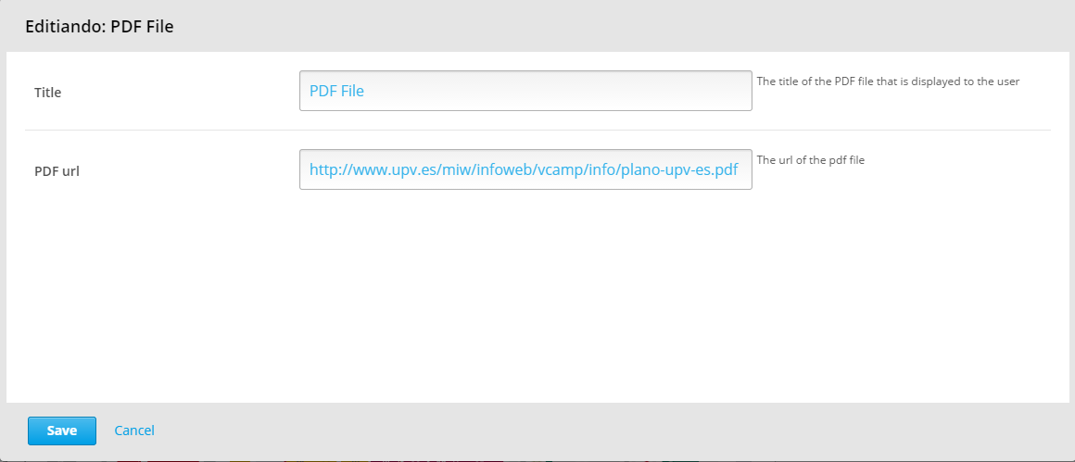
Our XBlocks: PDF viewer

Slide 9
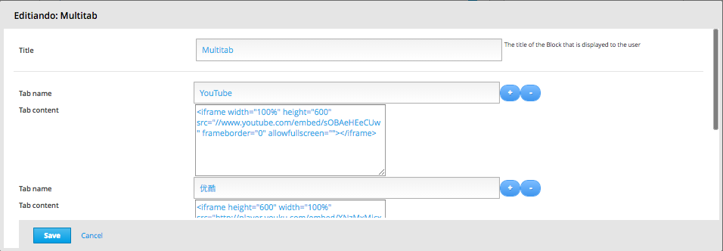
Our XBlocks: Multitab Viewer

Slide 10
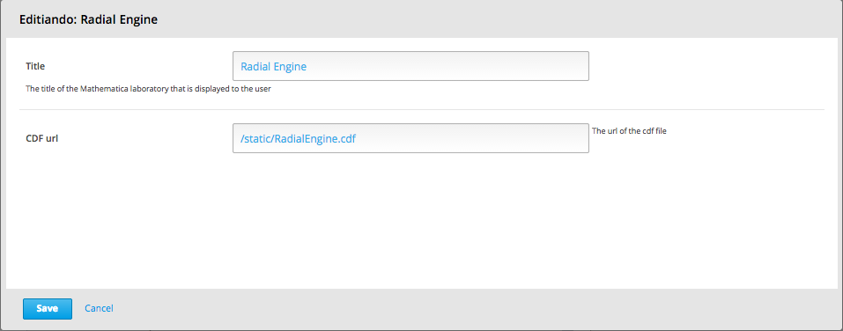
Our XBlocks: Mathematica Viewer

Slide 11
Our XBlocks: Paella Player

Slide 12
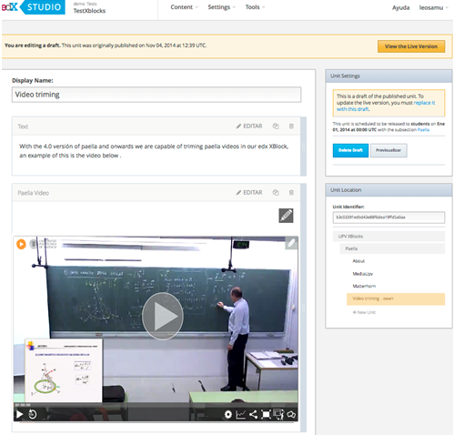
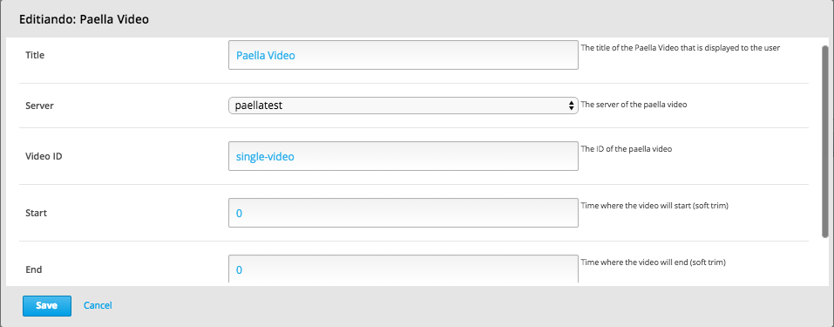
Our XBlocks: Paella Player

Slide 13
License & conclusions
GPL license
Source code on https://github.com/polimediaupv/
Demos on http://demo.edx.upv.es/xblock
Full list on https://github.com/edx/edx-platform/wiki/List-of-XBlocks
Thanks!
turro@cc.upv.es
leosamu@upv.es
“No cat was harmed during the development of these XBlocks”

