Slide 1
Tool Integration with LTI
Phil McGachey
Tech Lead
Teaching and Learning Technologies

Slide 2
The Problem
Harvard uses edX for online courses
Scale
Support
Reach
We use Canvas for on-campus courses
Residential LMS tool set
Integration with campus systems
We want to share content between the two systems
We are actively developing new pedagogical tools

Slide 3
Learning Tools Interoperability
Standard protocol to integrate tools
Connects systems across address spaces
Allows information to pass between components
Very widely supported
Growing ecosystem of third-party tools
Encourages experimentation
Simple to set up
Very localized failure

Slide 4
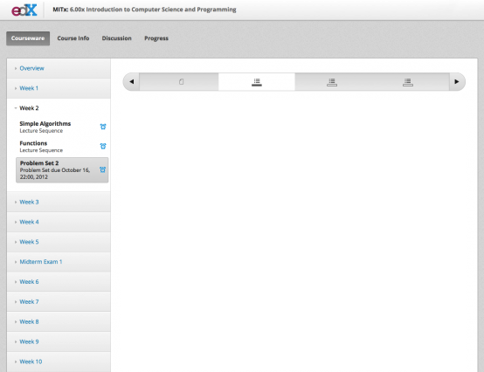
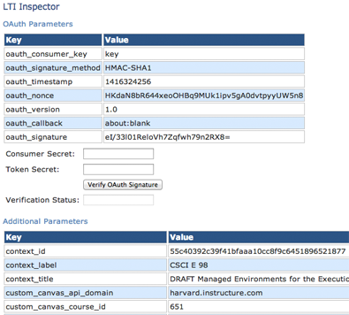
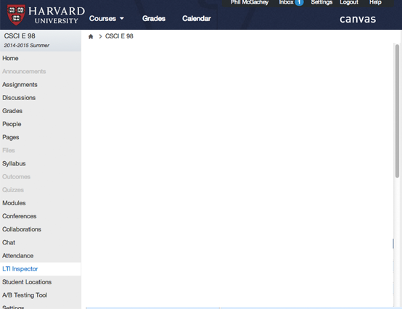
LTI Consumer
HTML
LTI Launch
LTI Provider
LTI Consumer
LTI Launch
HTML

Slide 5
Plans for Open edX
There are two parties in an LTI exchange
Consumer
Provider
We want edX to be both
Consumer to connect to external LTI tools
Provider to export edX course materials
Approaching as two initiatives
A lot of the same people in each

Slide 6
Open edX as a Tool Consumer
edX already accepts LTI tools
Enable using a custom configuration setting
Want to improve the user experience
Simplify the process of adding a tool
Build a registry to make LTI tools easily accessible
Offer tight control over user data passed to tool
Backend changes to support evolving standard

Slide 7
LTI Versions
Basic LTI (version 1.0), May 2010
First version of the standard
Version 1.1, March 2012
Added outcome reporting
Version 1.1.1, August 2012
Minor fixes and role addition
Version 2.0, January 2014
Major overhaul
Version 1.2, April 2014
Added content item message, other minor tweaks

Slide 8
LTI 2.0
Service Negotiation
Provider and consumer agree on supported features
Allows very fine-grained configuration
Tool Proxy
Single place to access services on the provider
Standard services
Decouple provider from consumer APIs

Slide 9
Open edX as a Tool Provider
Flip the role of edX in the LTI exchange
Open edX is now the provider
Canvas or other LMS is the tool consumer
Build an LTI wrapper around edX component
Focus initially on assessments
Bring in other assets as we go
Make edX content appear seamlessly in LMS

Slide 10
Student Experience
Single Sign-on
Students will launch tool explicitly or implicitly
First launch may involve account management
Resource Presentation
Only the requested module will be shown
No navigation or other clutter
Grade Passback
Use the LTI 1.1 standard to return a grade or completion

Slide 11
Instructor Experience
Link to or create an edX course
Some way to discover available resources
Create edX groups from the campus system
Bulk operation to create user accounts
Want to create anonymous users with no PII
Configure edX tool from campus system
Prompt user for any other necessary information

Slide 12
Call for Participation
Working groups have been formed
Currently in the early phases
Tool provider MVP planned out
Work is run through the Open edX community
We welcome any more assistance
Beth Porter from edX is organizing the groups
Contact her or Phil with questions or comments

