Slide 1


Contributing
to Open edX
Sarina Canelake
sarina@edx.org
Xavier Antoviaque
xavier@opencraft.com
This presentation and its content, except third-party images, is released under the AGPLv3 licence

Slide 2
WHY?
Notes:
Why should I contribute to Open edX?

Slide 3

“The Obliteration Room”, by Japanese artist Yayoi Kasumana & thousands of children
XKCD Comic by Randall Munroe, CC-BY-NC
Notes:
Would have been long and painstaking job to do all of this himself - and result would probably be less interesting
Linus’ Law "given enough eyeballs, all bugs are shallow" - if each of these dots are a bugfix or an improvement, it would likely be difficult for one person to notice them all

Slide 4
XKCD Comic by Randall Munroe, CC-BY-NC
Notes:
That’s the theory at least… What often happens is that, when we find a “dot”, something to contribute, we often end up keeping it for ourselves.

Slide 5
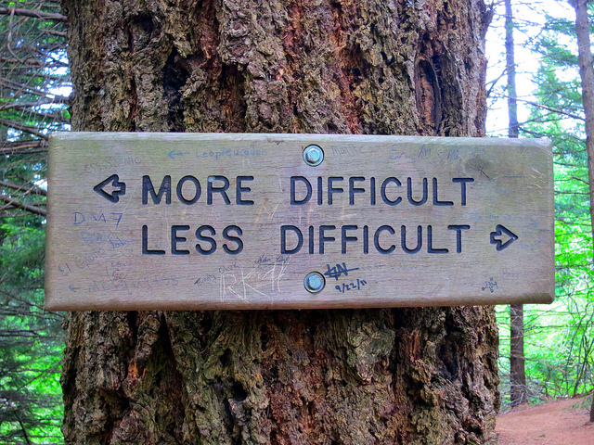
XKCD Comic by Randall Munroe, CC-BY-NC
Notes:
It looks like we’re confronted with a simple choice - do I take the simple path (just apply it locally), or the one that seem more difficult (contribute it upstream)?
And that’s true… at first.
Until...

Slide 6

XKCD Comic by Randall Munroe, CC-BY-NC
Notes:
...a new release come in!
Many people mistake “open source” for “I can do whatever I want with the code”. That’s true if you just want to fork out the code, and don’t about any future improvements. Otherwise, there is no escape to the fact that you become part of a community by the mere fact that you’re using Open edX. The decisions of the community will influence what appears on your site. You can chose to change things, but if you don’t make other members of the community aware of your changes, and ensure they use it themselves, you will have to keep redoing the change, adapting it over and over, every time the rest of the community changes the code on which you depend.
Many people see contributing as a purely selfless act - it’s not! You’re helping yourself, future you, by making sure that the changes you make to the project are taken into account by others.

Slide 7
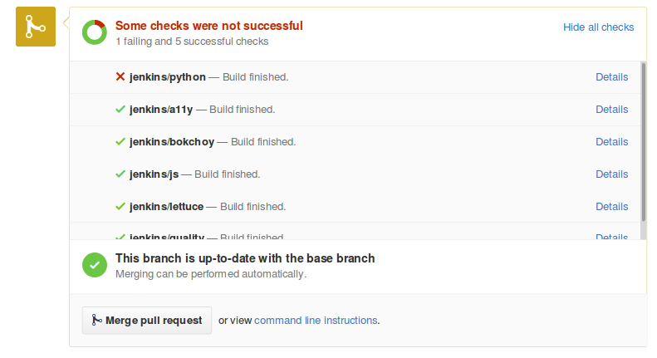
XKCD Comic by Randall Munroe, CC-BY-NC
Notes:
And the best way to do that is to get your change merged in the official project. This way, if anyone breaks your feature (or its tests), it won’t be merged until the additional change is reconciled with yours.
That little red cross, right there, can represent hours, or days of your work time, which you won’t have to spend fixing your change on the next release.

Slide 8
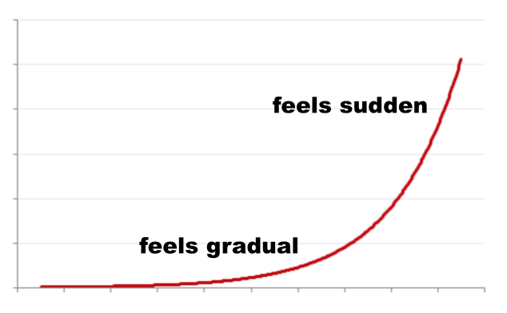
XKCD Comic by Randall Munroe, CC-BY-NC
Notes:
Especially because this problem accumulates, over time, and snowballs. When upgrading, some of the changes will require additional changes, which themselves will need to be maintained… And the project development speed isn’t slowing down either.
In some extreme cases (but which aren’t uncommon), upgrading to the new release can end up taking up to several months for a full team to reconcile such issues.
Sure, you gained some time initially, but you eventually end up spending more time on it on the long term, fixing superflous issues, and getting less quality of it.

Slide 9

XKCD Comic by Randall Munroe, CC-BY-NC
Notes:
Now, that’s not to say that there aren’t changes you shouldn’t keep on your fork. Your contribution might actually be refused, and in which case you won’t have a choice. And sometimes you might have to take shortcuts or meet deadlines. But the point is that you should treat code drift as as code smell, or technical debt. If you do have to contract some of that debt, you would better have a good plan to repay it, or you might end up repaying increasing interests, forever.

Slide 10

XKCD Comic by Randall Munroe, CC-BY-NC
Notes:
Also, if contributing a feature can require more work, it’s not useless work. To the contrary, you will end up exchanging with skilled developers, who will spend time looking at your code and reviewing it - not a useless confirmation when you have to release your code to thousands, if not hundred of thousands of learners.
And you get it for free! When you contribute code, it’s not just you making a gift - it’s also other developers from the projects giving some of their time to make your code better.
If you’re looking for a more satisfying work (or retain/attract good developers), adding the extra challenge of requiring all code changes to be contributed upstream can be very rewarding - not just for the pleasure of contributing to the community, but also because you’re going to end up being much more proud of your work.

Slide 11
HOW?
Notes:
Why should I contribute to Open edX?

Slide 12
Mailing-list Discussion
WIP PR
Product Review
Domain Experts Reviews
Waiting for Prioritization
Community Manager Review
Merge & verification
Notes:
Looks frightening!

Slide 13
THE ZEN OF PRs
Get buy-in
Write code & post it
Be responsive to reviews
Notes:
But is really 3 main steps - you can forget the rest of the talk, if you keep these 3 steps in minds (and in that order), you should be fine.

Slide 14
GET BUY IN
Mailing-list Discussion
WIP PR
Product Review
Domain Experts Reviews
Waiting for Prioritization
Community Manager Review
Merge & verification

Slide 15
WRITE CODE & POST IT
Mailing-list Discussion
WIP PR
Product Review
Domain Experts Reviews
Waiting for Prioritization
Community Manager Review
Merge & verification

Slide 16
BE RESPONSIVE TO REVIEWS
Mailing-list Discussion
WIP PR
Product Review
Domain Experts Reviews
Waiting for Prioritization
Community Manager Review
Merge & verification

Slide 17
EXAMPLE

Slide 18
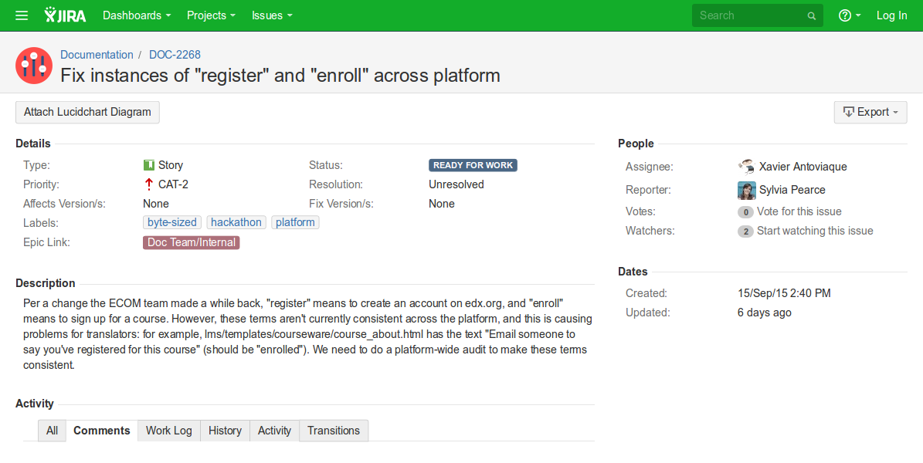
BYTE-SIZED TASK
http://bit.ly/edxbugs
Notes:
By implementing an existing byte-sized ticket, you get to start with something that already has approval

Slide 19
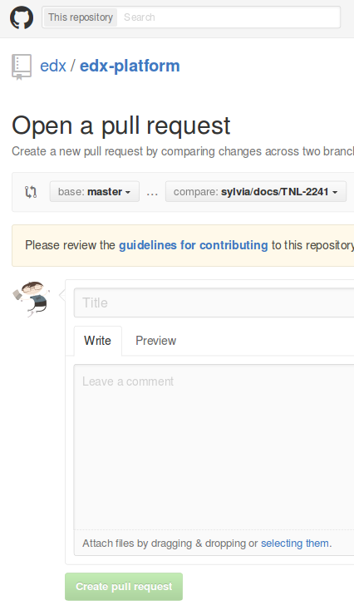
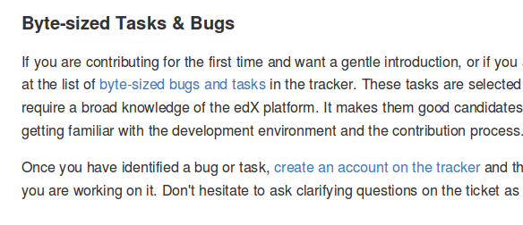
BYTE-SIZED TASK
http://bit.ly/edxbugs

Slide 20
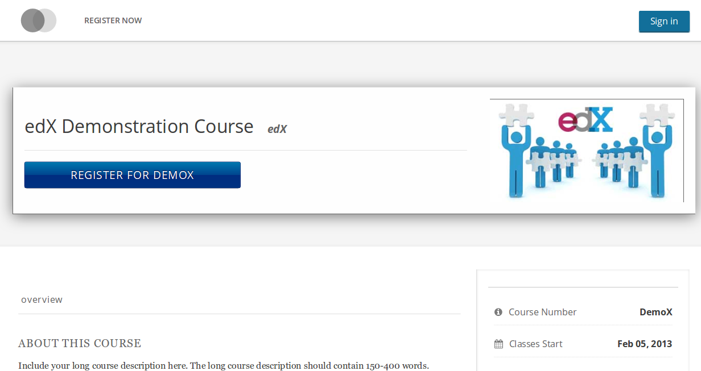

Slide 22
GET BUY IN
Mailing-list Discussion
WIP PR
Product Review
Domain Experts Reviews
Waiting for Prioritization
Community Manager Review
Merge & verification

Slide 23

GET BUY IN
Mailing-list Discussion
WIP PR
Product Review
Domain Experts Reviews
Waiting for Prioritization
Community Manager Review
Merge & verification

Slide 24
GET BUY IN
Mailing-list Discussion
WIP PR
Product Review
Domain Experts Reviews
Waiting for Prioritization
Community Manager Review
Merge & verification

Slide 25
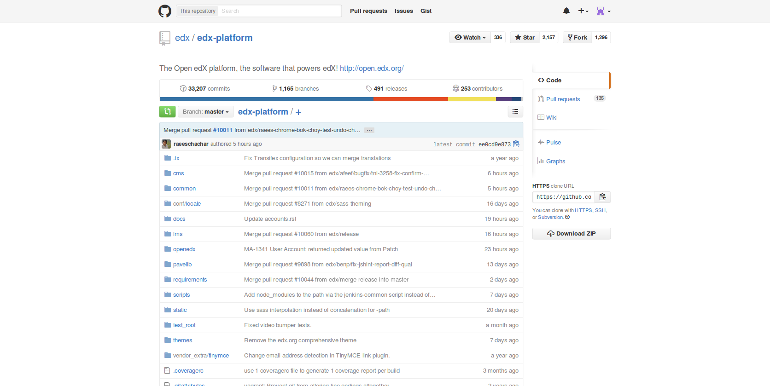

Slide 26
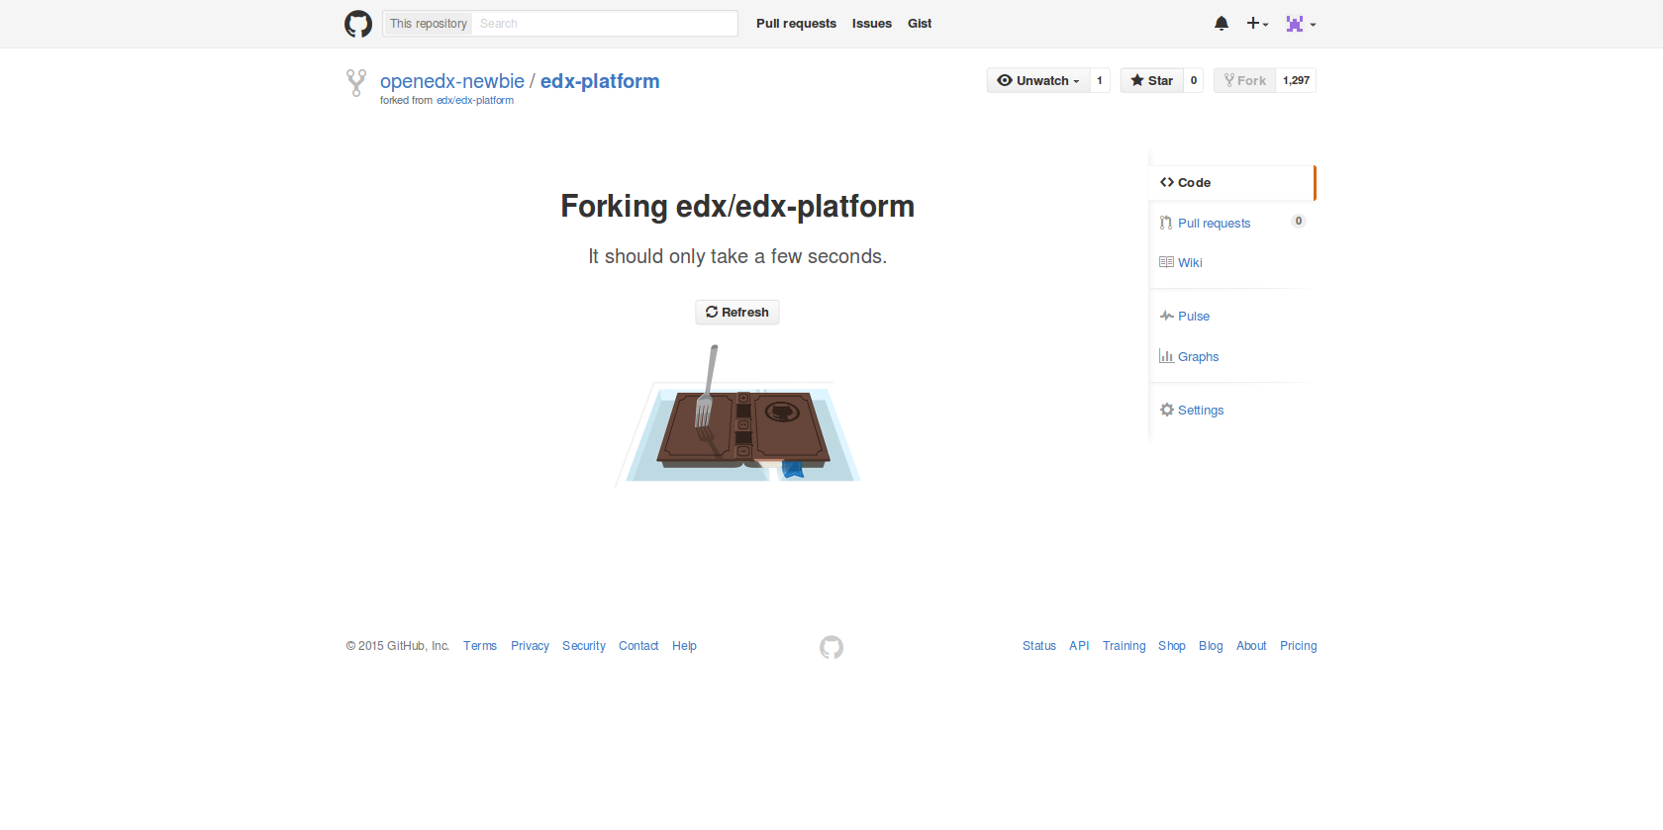

Slide 27
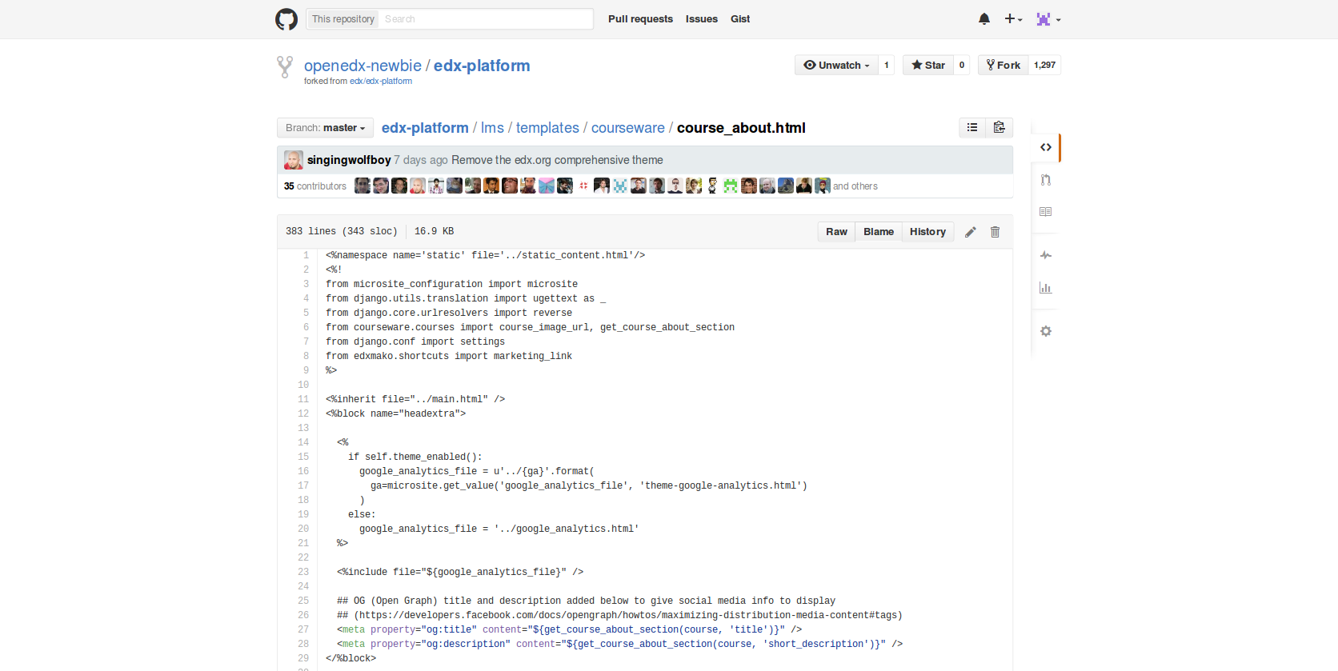

Slide 29
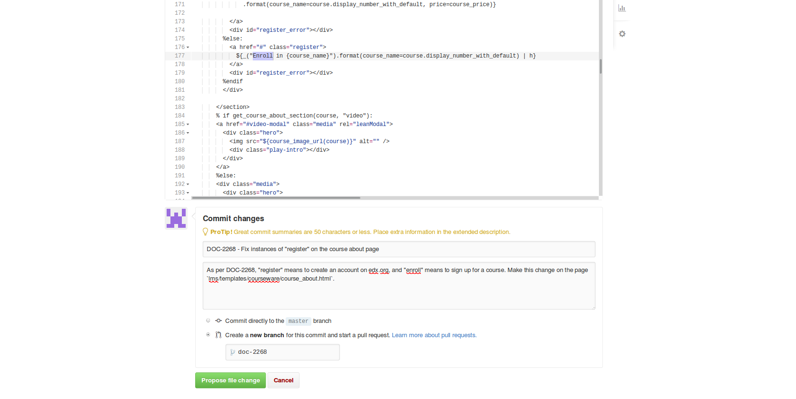

Slide 32
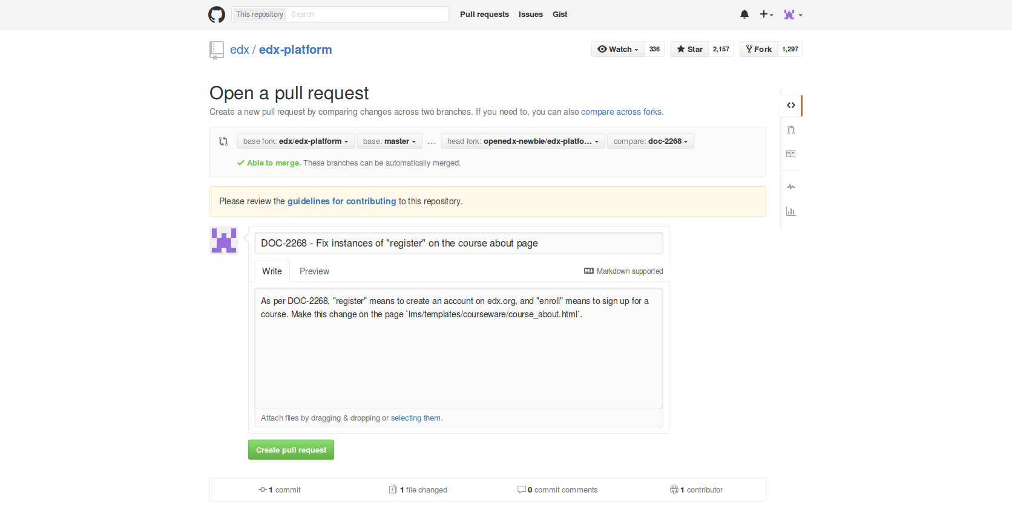

Slide 37
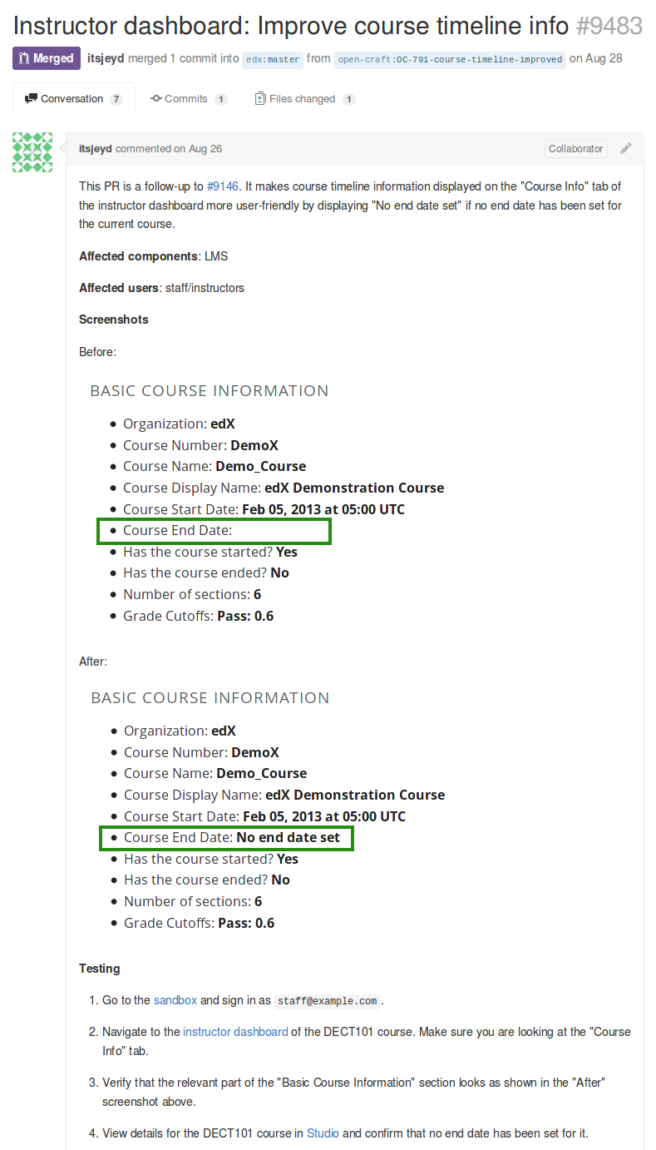
COVER LETTER
Meaningful title
Why do you do this?
What problem does it solve?
Before/after screenshots
Test instructions
http://edx.readthedocs.org/projects/edx-developer-guide/en/latest/process/cover-letter.html

Slide 38
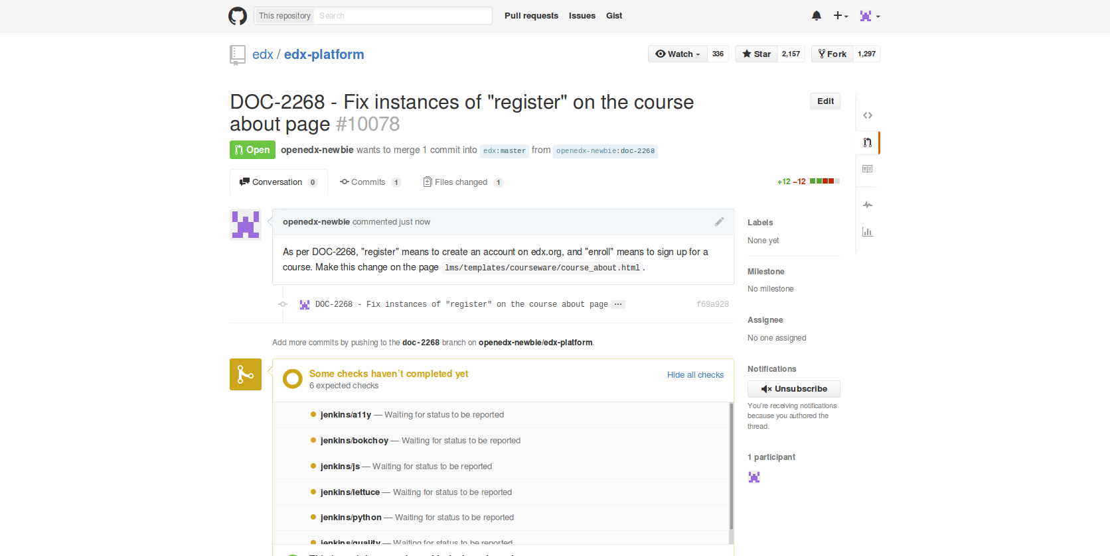

Slide 39
WIP PR
Mailing-list Discussion
WIP PR
Product Review
Domain Experts Reviews
Waiting for Prioritization
Community Manager Review
Merge & verification

Slide 40
WIP PR
Mailing-list Discussion
WIP PR
Product Review
Domain Experts Reviews
Waiting for Prioritization
Community Manager Review
Merge & verification

Slide 41


Slide 42
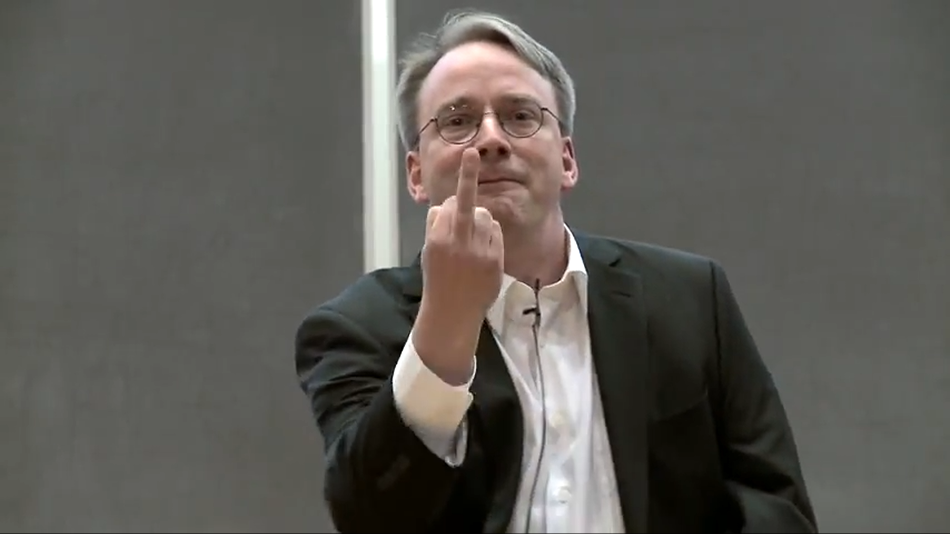

Slide 43

REVIEWS

Slide 44
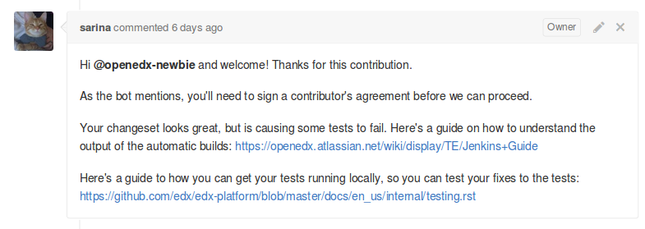
COMMUNITY MANAGER REVIEW
Test coverage
Passing build (tests: unit, integration, pylint, accessibility...)
Review of general code quality

Slide 45
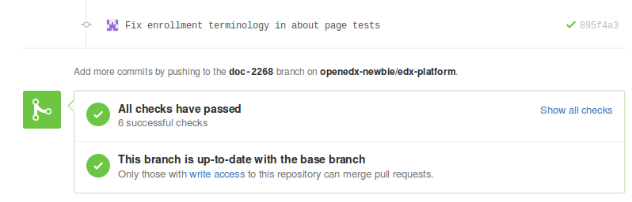
COMMUNITY MANAGER REVIEW

Slide 46
COMMUNITY MANAGER REVIEW

Slide 47
COMMUNITY MANAGER REVIEW
Notes:
login: openedx-newbie
password: bozoleclown1

Slide 48
REVIEWS
Mailing-list Discussion
WIP PR
Product Review
Domain Experts Reviews
Waiting for Prioritization
Community Manager Review
Merge & verification

Slide 49
REVIEWS
Mailing-list Discussion
WIP PR
Product Review
Domain Experts Reviews
Waiting for Prioritization
Community Manager Review
Merge & verification

Slide 50

WAITING FOR PRIORITIZATION
Notes:
Need to wait for the right person/team to become available to review
Need to be patient - can ask, but not every day; already advocating within teams
Example: django 1.8

Slide 51
REVIEWS
Mailing-list Discussion
WIP PR
Product Review
Domain Experts Reviews
Waiting for Prioritization
Community Manager Review
Merge & verification

Slide 52
REVIEWS
Mailing-list Discussion
WIP PR
Product Review
Domain Experts Reviews
Waiting for Prioritization
Community Manager Review
Merge & verification

Slide 53
DOMAIN EXPERT REVIEWS
User experience (UX)
Architecture / platform
Accessibility
Internationalization
Analytics
Mobile
Documentation
...

Slide 54
REVIEWS
Mailing-list Discussion
WIP PR
Product Review
Domain Experts Reviews
Waiting for Prioritization
Community Manager Review
Merge & verification

Slide 55
REVIEWS
Mailing-list Discussion
WIP PR
Product Review
Domain Experts Reviews
Waiting for Prioritization
Community Manager Review
Merge & verification

Slide 56
REVIEWS
Mailing-list Discussion
WIP PR
Product Review
Domain Experts Reviews
Waiting for Prioritization
Community Manager Review
Merge & verification

Slide 57
(BIGGER) EXAMPLE
XKCD Comic by Randall Munroe, CC-BY-NC

Slide 58
PARTIAL CREDIT
Mailing-list Discussion
Feature Proposal
Product Review
Domain Experts Reviews
Waiting for Prioritization
Community Manager Review
Merge & verification

Slide 59
MAILING LIST DISCUSSION
Mailing-list Discussion
Feature Proposal
Product Review
Domain Experts Reviews
Waiting for Prioritization
Community Manager Review
Merge & verification

Slide 60
MAILING LIST DISCUSSION
Mailing-list Discussion
Feature Proposal
Product Review
April 2015
http://bit.ly/edx-pc-proposal
Domain Experts Reviews
Waiting for Prioritization
Community Manager Review
Merge & verification

Slide 61
FEATURE PROPOSAL
Mailing-list Discussion
Feature Proposal
Product Review
Domain Experts Reviews
Waiting for Prioritization
Community Manager Review
Merge & verification

Slide 62
FEATURE PROPOSAL
Mailing-list Discussion
Feature Proposal
Product Review
April - June 2015
openedx.atlassian.net/browse/OSPR-535
Domain Experts Reviews
Waiting for Prioritization
Community Manager Review
Merge & verification

Slide 63
PRODUCT REVIEW
Mailing-list Discussion
Feature Proposal
Product Review
Domain Experts Reviews
Waiting for Prioritization
Community Manager Review
Merge & verification

Slide 64
CM REVIEW
Mailing-list Discussion
Feature Proposal
Product Review
Domain Experts Reviews
Waiting for Prioritization
Community Manager Review
Merge & verification

Slide 65
CM REVIEW
Mailing-list Discussion
Feature Proposal
Product Review
edx-platform pull requests:
June: #8574
July: #8724
Domain Experts Reviews
Waiting for Prioritization
Community Manager Review
Merge & verification

Slide 66
WAITING FOR PRIORITIZATION
Mailing-list Discussion
Feature Proposal
Product Review
Domain Experts Reviews
Waiting for Prioritization
Community Manager Review
Merge & verification

Slide 67
DOMAIN EXPERTS REVIEWS
Mailing-list Discussion
Feature Proposal
Product Review
Domain Experts Reviews
Waiting for Prioritization
Community Manager Review
Merge & verification

Slide 68
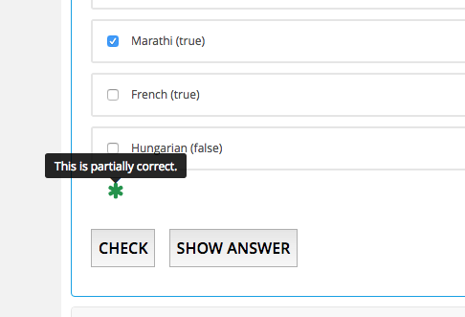
DOMAIN EXPERTS REVIEWS
Mailing-list Discussion
Feature Proposal
Product Review
UX
Domain Experts Reviews
Waiting for Prioritization
Community Manager Review
Merge & verification

Slide 69
DOMAIN EXPERTS REVIEWS
Mailing-list Discussion
Feature Proposal
Product Review
UX
Analytics
Teaching & Learning
Accessibility
Domain Experts Reviews
Waiting for Prioritization
Community Manager Review
Merge & verification

Slide 70
MERGE & VERIFICATION
Mailing-list Discussion
Feature Proposal
Product Review
Domain Experts Reviews
Waiting for Prioritization
Community Manager Review
Merge & verification

Slide 71
THANKS!
See you in the pull requests! : )
(or at the hackathon)
Sarina Canelake
sarina@edx.org
Xavier Antoviaque
xavier@opencraft.com

