Slide 1
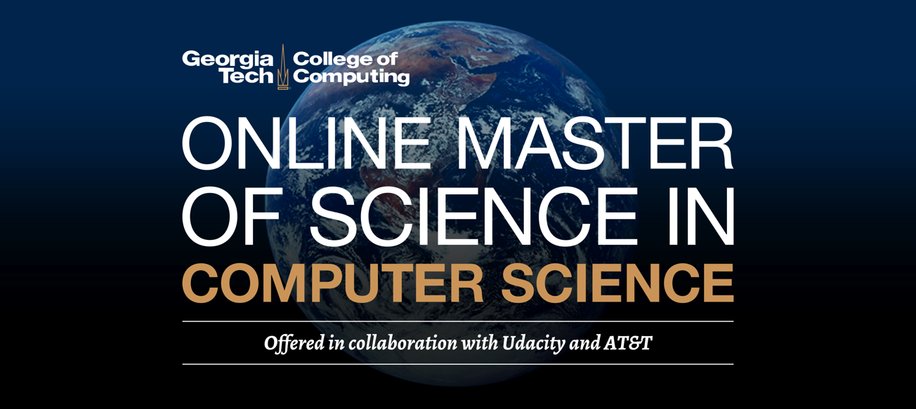
Best education in the world: Now available to the world

Slide 2
OMSCS: What Are We Talking About?
OMSCS: Online Master of Science in Computer Science
Collaboration among GT, Udacity & AT&T
Announced on May 14, 2013
Program launch Jan. 15, 2014

Slide 3
The OMSCS Motto
Accessibility through
Affordability and Technology
OMSCS total degree cost: ~$6,600
Typical MS CS (public university, out-of-state) ~$40,000
Typical MS CS (private university) ~$70,000
World’s only accredited MOOC-based degree in CS

Slide 4
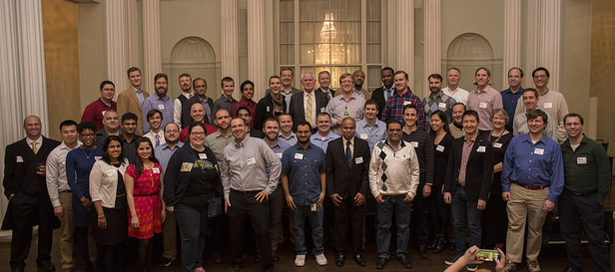
Here’s Where We Are
1,236 total graduates to date
Spring 2018 enrollment: 6,365 students
Harvard Univ: OMSCS is largest MS CS program in U.S., maybe world
Domestic/international ratio slowly shifting (now 30% international)

Slide 5
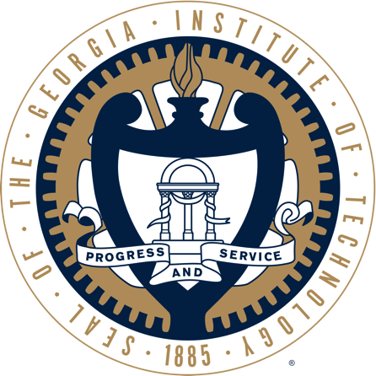
Rationale – Part 1
Georgia Tech motto: “Progress & Service”
College of Computing (CoC) history
of educational innovation
M.S. & CS are best places to start
Now is the right time for this experiment
  Rapidly maturing technology
  46 courses with Coursera & edX
  Served ~2.6M total learners

Slide 6
Rationale – Part 2
Many students want to go beyond learning—they want degrees/credentials
Larger pool of prospective students (incl. nontraditional)
Redefine learning experience to be more student-focused
Address shortage of trained computing professionals
New pipeline for Ph.D. students

Slide 7
Rationale – Summary
So … why are we doing this?
Because we can,
and we should

Slide 8
$6,600 Degree – How We Got There
Price must match cost to achieve scale
Goal is to expand access through reduced cost
$2M from AT&T critically important
Fixed costs do not scale
Efficiency of execution

Slide 9
Building College Consensus
Appointed faculty Working Group (no administrators)
College leadership minimized presence in deliberations
WG gave 6+ months to project
Final proposal affirmed by 75% of College faculty
Main concern: Quality, quality, quality
GT leadership support critical
President & Provost socialized idea with key Regents & USG officers prior to Board of Regents vote

Slide 10
Overall Applications
20,500+ unique applicants, October 2013 to current
  Admission rate 60+%
149 countries represented & all 50 U.S. states
Vast majority are degree-holders working in computing/IT
  Nearly 5,400 applicants have advanced degrees (1,064 terminal degrees, including 219 PhDs)
73% domestic applicants—inverse of on-campus MS CS
Indicates we are expanding the market, not ‘cannibalizing’
on-campus MS CS program

Slide 11
Overall Enrollment (Spring 2018)
10,178 unique enrollments since launch (88.4% yield)
  6,365 enrolled at start of Spring 2018 semester
Demographics:
  Average age: 33 (~11 years older than on-campus MS CS)
  72% are U.S. citizens or permanent residents
  54 U.S. states/territories & 119 countries represented
  2,420 enrolled students w/advanced degrees; 535 have terminal degrees including 87 PhDs

Slide 12
International Enrollment
On-campus MS CS enrollment (Fall 2017)
  Total enrollment: 306
  India: 122 (40%)
  China: 92 (30%)
  South Korea: 8 (3%)
OMSCS (Spring 2018)
  Total: 6,365
  India: 761 (12%)
  China: 715 (11.2%)
  Canada: 126 (2%)

Slide 13
Retention per Semester
Fall 2016: 3,944 > 3,347
  597 dropped (14%)
  Of those 597, 399 started Spring term
  Total lost: 198 (5%)
Spring 2017: 4,515 > 3,765
  750 dropped (16.6%)
  Of those 750, 522 started Fall term
  Total lost: 228 (5%)

Slide 14
Retention per Year
2014: 1,388 started
  458 graduated (33%)
  321 are still enrolled (23.1%)
  609 stopped (44%)
2015: 2,122 started
  379 graduated (17.9%)
  841 still enrolled (39.6%)
  903 stopped (43%)
Survival rate is nearly 60%

Slide 15
OMSCS – Enrollment Growth
?
…

Slide 16
OMSCS – Enrollment Diversity

Slide 17
OMSCS Curriculum (Spring 2018)
CS 6035 Introduction to Information Security
CS 6210 Advanced Operating Systems
CSE 6220 Intro to High-Performance Computing
CSE 6242 Data & Visual Analytics
CS 6250 Computer Networks
CS 6262 Network Security
CS 6290 HPC Architecture
CS 6300 Software Development Process
CS 6310 Software Architecture and Design
CS 6340 Software Analysis & Test
CS 6400 Database Systems Concepts & Design
CS 6440 Intro to Health Informatics
CS 6460 Educational Technology
CS 6475 Computational Photography
CS 6476 Computer Vision
CS 6505 Computability, Complexity & Algorithms
CS 6601 Artificial Intelligence
CS 6750 Human-Computer Interaction
CS 7637 Knowledge-Based AI: Cognitive Systems
CS 7641 Machine Learning
CS 7646 Machine Learning for Trading
CSE 8803 Big Data for Health Informatics
CS 8803 GA Graduate Algorithms
CS 8803 Cyber-Physical Design & Analysis
CS 8803-001 Artificial Intelligence for Robotics
CS 8803-002 Introduction to Operating Systems
CS 8803-003 Reinforcement Learning
CS 8803-004 Embedded Software
CSE 8803-007 Cyber-Physical Systems Security
CSE 8803 Compilers – Theory & Practice

Slide 18
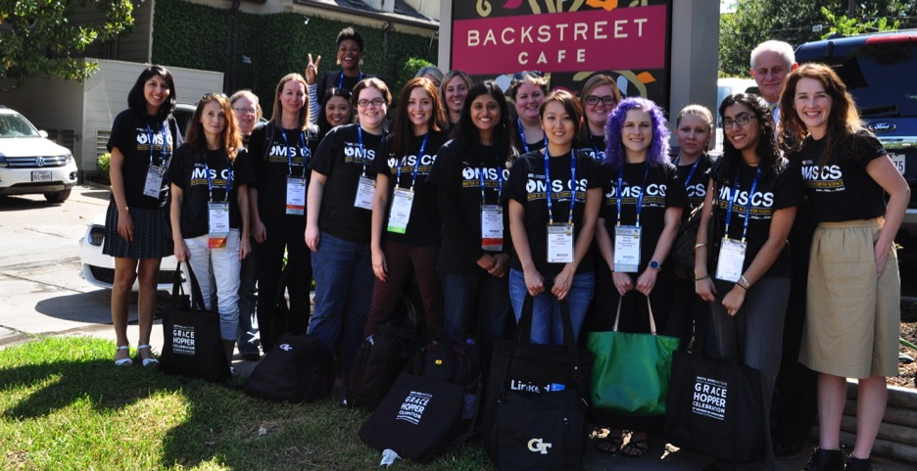
OMSCS: Dozens of Student Communities
Google+, Facebook, LinkedIn, Slack, etc.
Main Google+ community has 7,771 members
Student Facebook group has 2,067 members

Slide 19
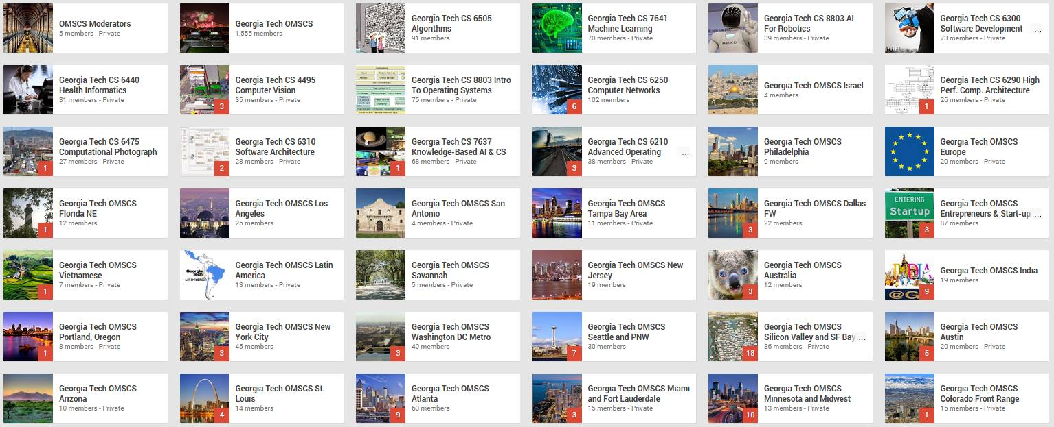
OMSCS @ Google+ (66 groups)

Slide 20

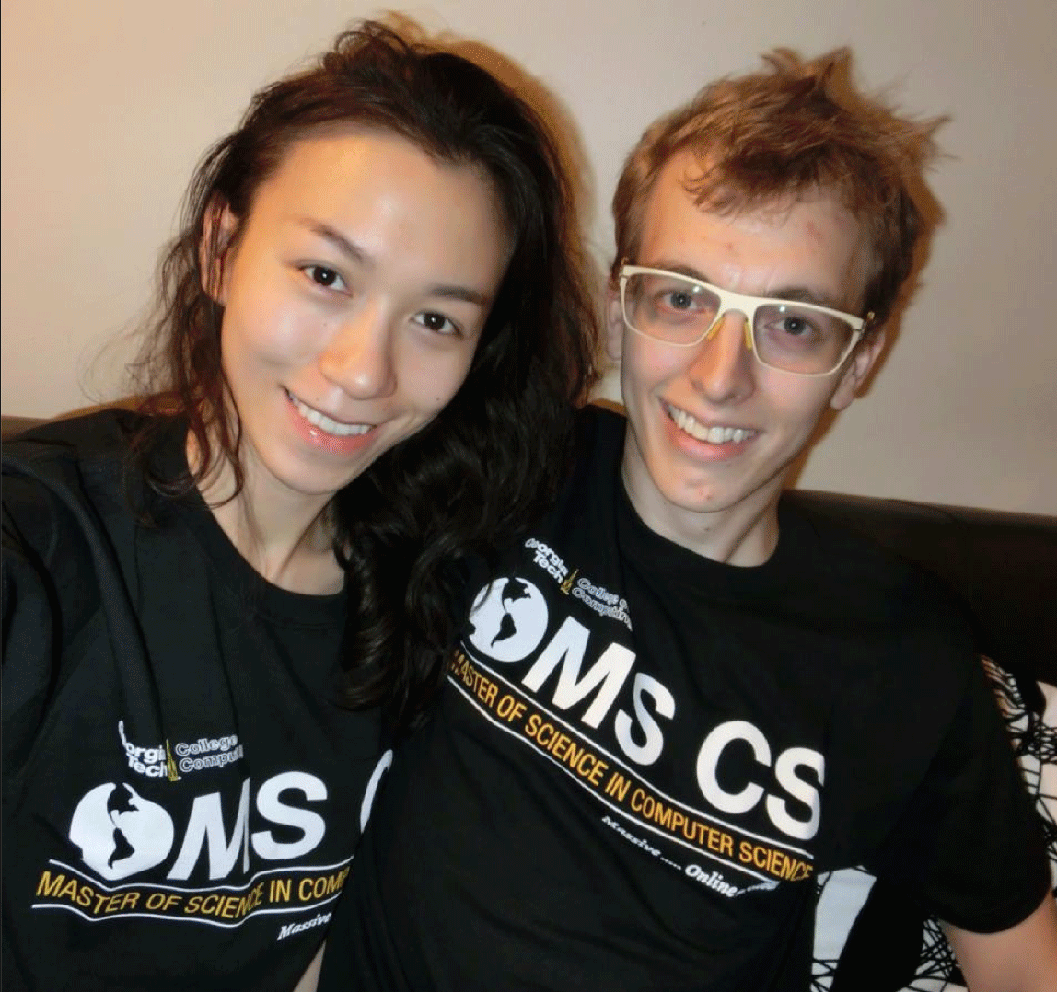
Showing Their GT Computing Spirit

Slide 21
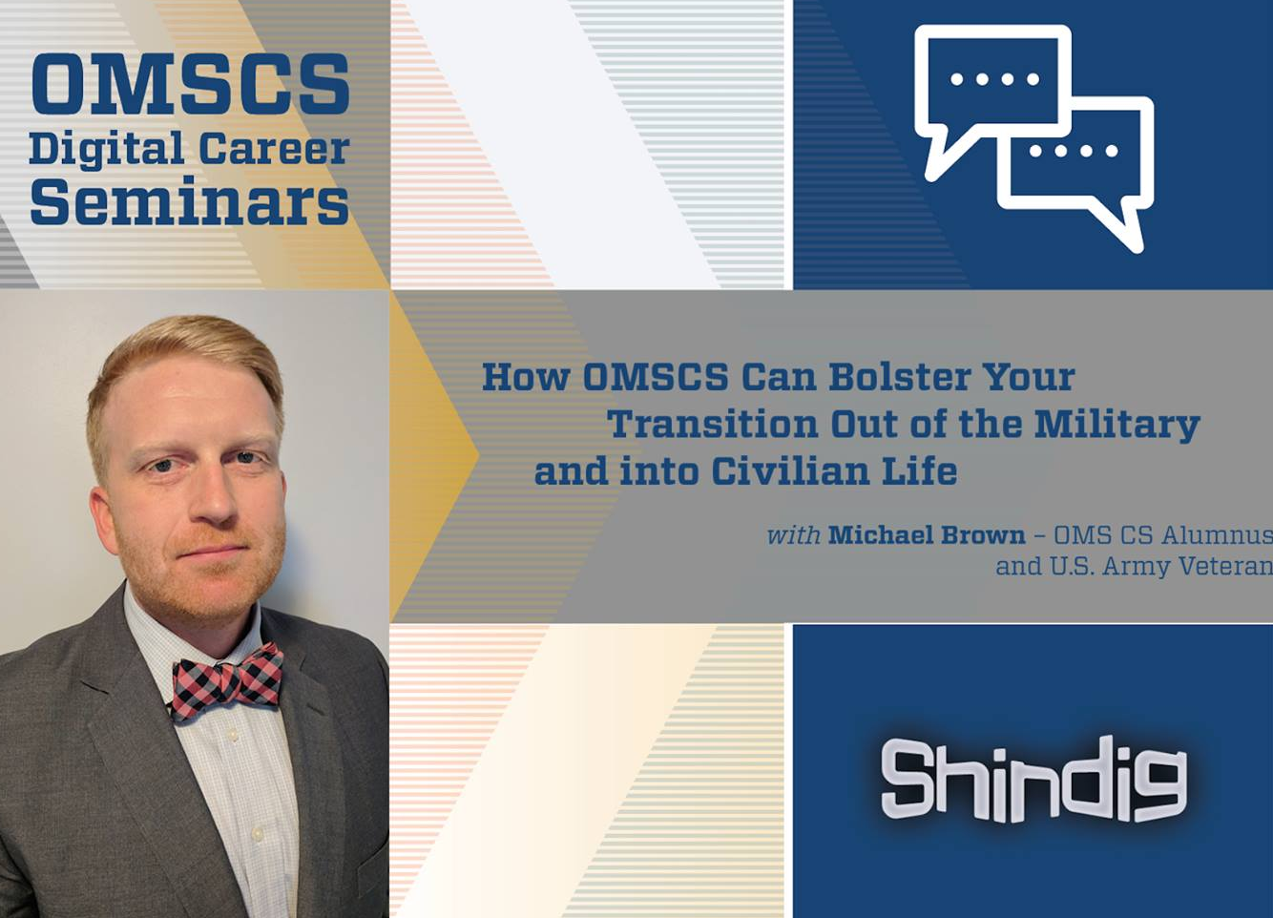
Georgia Tech Survey of OMSCS students
93% would recommend
to a friend
97% said OMSCS is good or great value

Slide 22
Lessons Learned
There is a large, unmet demand
You can’t learn from what you don’t try
Students are extremely engaged—officially & unofficially
  Interacting via self-created social media groups
  Providing significant peer support
  Many students eager to serve as TAs
They need better program guidance
  We must develop online advising process
  Expectation-setting is essential
  A degree program is not just a collection of courses—it’s a community built around common interests and goals

Slide 23
More Lessons Learned
Not difficult to create quality product
Scalability
  Day-to-day support scales (mostly)
  Grading does not scale without creativity
  Intentional advising very difficult to scale
Technology must improve
  Community support
  Test-taking & projects
Course discussions are not just possible but frequent

Slide 24
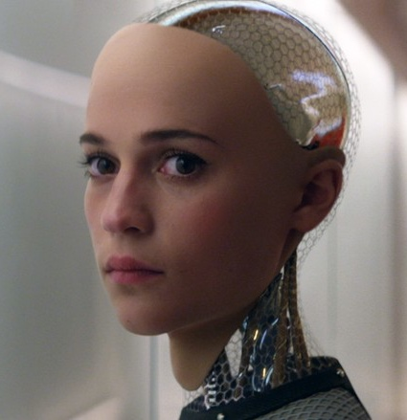
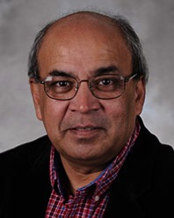
Jill Watson: Our Newest TA
Creation of Prof. Ashok Goel
TA for CS 7637: Knowledge-Based Artificial Intelligence
Based on IBM Watson platform
Anticipate that Jill will be able to answer 40% of ~10,000 questions posted to online forum
Ashok Goel
From the 2015 film, Ex Machina

Slide 25
Even More Lessons Learned
Online, students have control
  Forum-based classroom puts students in driver’s seat
OMSCS students are uniquely qualified
  Many employed by companies like Google, Amazon & SpaceX
Giving uniquely qualified students control drastically improves the class for all students
Anecdotes: Students in Educational Technology include current teachers; students in Health Informatics include current physicians

Slide 26

Harvard Study @ OMSCS Shows:
Vast majority of OMSCS students would not pursue advanced degree if not for this program
“This is the first rigorous evidence that we know of showing an online degree program can increase educational attainment.”
OMSCS is the largest MS CS program in the United States, and possibly the world.
“This single program will boost annual national production of American computer science master’s degrees by at least seven percent.”

Slide 27
Jobs I
College of Computing offers array of career services
  Career Fairs: ‘real’ & virtual
  Corporate Affiliates Program: information sessions & visits
  from top employers
  Personal career counseling
OMSCS students have started hiring other OMSCS students

Slide 28
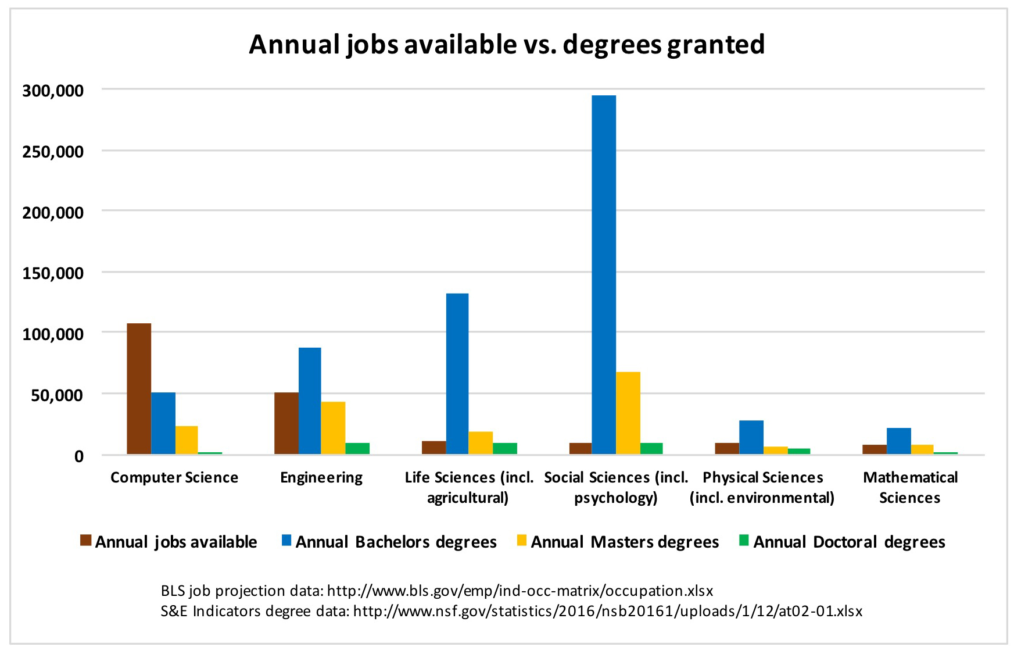
Jobs II

Slide 29
Jobs III
Now
Projection
* U.S. Department of Education, National Center for Education https://nces.ed.gov/programs/digest/d12/tables/dt12_313.asp

Slide 30
Impact on Campus Enrollments
MS CS applications up >100% in last 4 years
  2014: +30%
  2015: +18%
  2016: +16%
  2017: +13%
Undergraduate BS CS up >400% in last 4 years
  2014: +85%
  2015: +35%
  2016: +31%
  2017: +57%
Overall BS CS apps up >1,000% since 2008

Slide 31
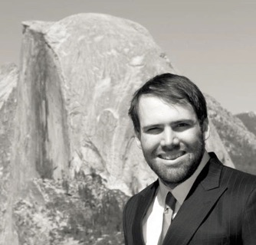
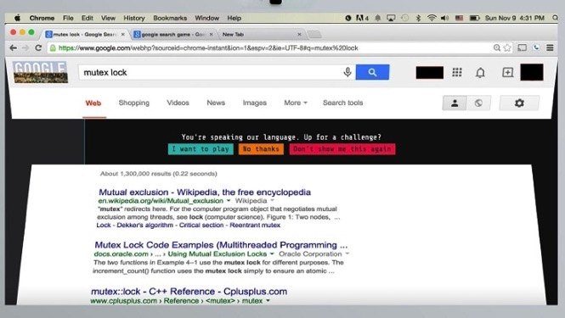
Real Proof:
Here’s
What It
Looks
Like
Student Max Rosett uses Google
for help with OMSCS course
Search terms trigger ‘secret interview’ – ‘You’re speaking our language’
Max, MS CS ’16, now employed by Google
Generated 100+ news articles
in at least 17 languages

Slide 32
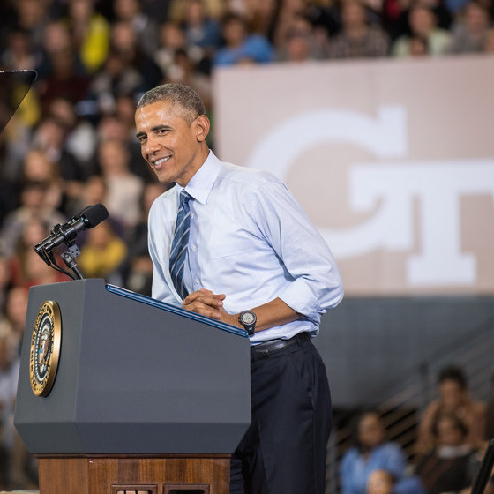
Friends in High Places
Former POTUS
Seals of Approval
  August 22, 2013
  (University of Buffalo)
  March 10, 2015
  (Georgia Tech)

Slide 33
Measuring Success
All courses are top quality (and we continually evaluate)
Identical online and on-campus assessments
Enrollment scales
Financial viability
Employers accept & hire graduates on equal terms

Slide 34
Followers in Our Footsteps
University of Illinois (Coursera)
iMBA
Data Science
Accounting
MicroMasters w/edX
MIT, University of Michigan, Columbia University, UC-Berkeley & San Diego, University of Maryland, Boston University, University of Queensland, University of Pennsylvania, University of British Columbia, and more…
Georgia Tech
OMS Analytics (via edX) & Cybersecurity
University of Colorado-Boulder
MS Electrical Engineering
Coursera (Spring 2018)
Arizona State University (MS CS)
University of Illinois-UC (MS CS)
Imperial College London (MPH)
University of London (BS CS)
University of Michigan (MPH, Data Science)

Slide 35
Concluding Thoughts
We don’t know all the answers—this is uncharted territory
Multiple research projects
Overwhelming reaction, mostly positive
Tremendous opportunity to offer advanced CS training in regions that lack quality options
How do we scale critical processes (grading, student support, advising)?
Where is it all going?

Slide 36
Spring 2017: MOOCs go undergrad
  Online, MOOC-based CS 1301 – Intro to Computing with Python
  Taught by David Joyner, highly rated OMSCS instructor
  Uses ‘smartbook’ created with McGraw-Hill Education
  Started on campus with one section for credit & limited enrollment (~50 students)
  MOOC version through edX

Slide 37
CS 1301: For-credit section
Since Spring 2017, 440 residential GT students have taken Intro to Computing online, vs. 1,073 taking traditional course
Learning outcomes: No statistical difference in pre- and post-tests between online and residential students
Feedback from all online students:
  94% say 1301 is at least as good as their other college courses
  81% say 1301 is better than their other courses

Slide 38
CS 1301: MOOC section
Current enrollment: 70,836
Verified (paid) enrollment: 515
Active Learners: 1,419
Prior education: 28% high school or less; 27% advanced degree
Gender: 21.8% female
Countries represented: 196 (28% U.S.)

Slide 39

Vision, Dream, Hallucination?
  Can MOOCs put a dent in college costs?
    Intro courses via MOOC in high school
    Coursework during coops, internships
    Advanced courses on the job through OMSCS
    Shorten time spent on campus
  It all adds up to meaningful reduction in cost of undergraduate education

Slide 40
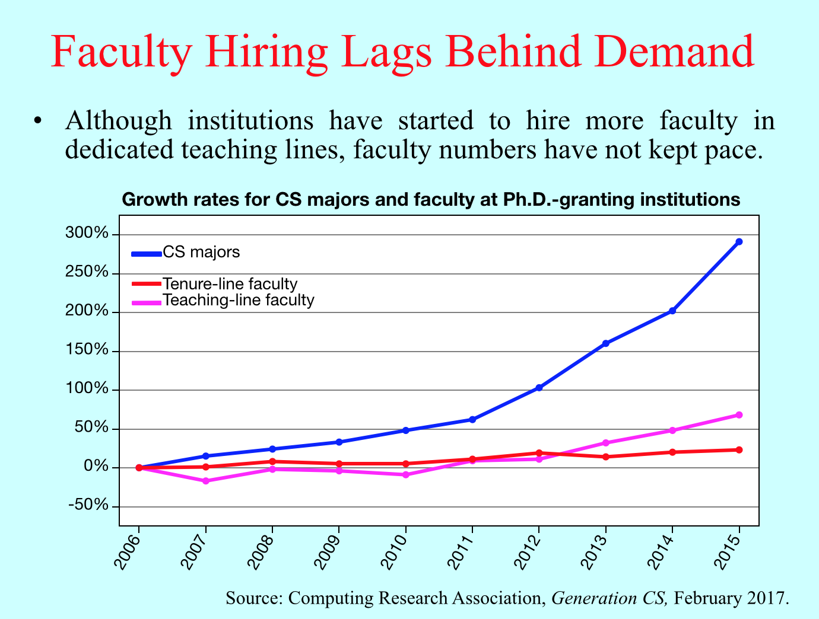
Another problem to solve
Serious shortage of CS professors
Graduation/hiring data from 2015:
  1,780 Ph.D. grads in CS
  18% took university teaching jobs
  1,577 U.S. schools offer CS degrees
  Each school could hire one Ph.D. every 5 years
  Solution: Leverage online courses
Source: Inside Higher Ed

