Slide 1
edX Architecture Onboarding

Slide 2
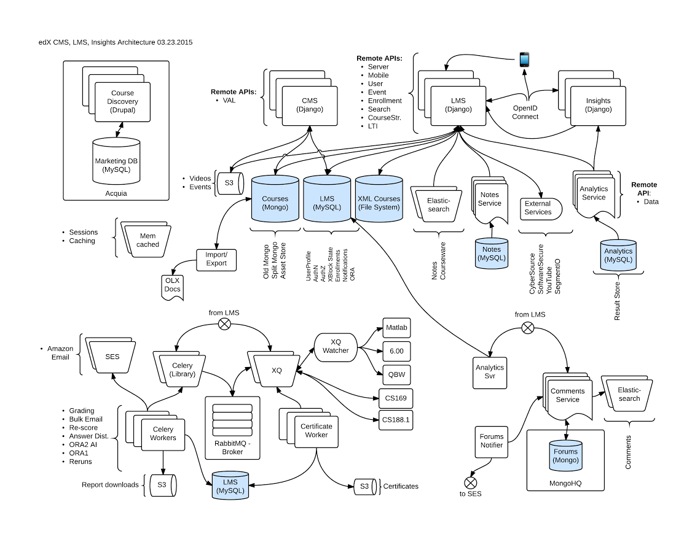
the whole shebang

Slide 3
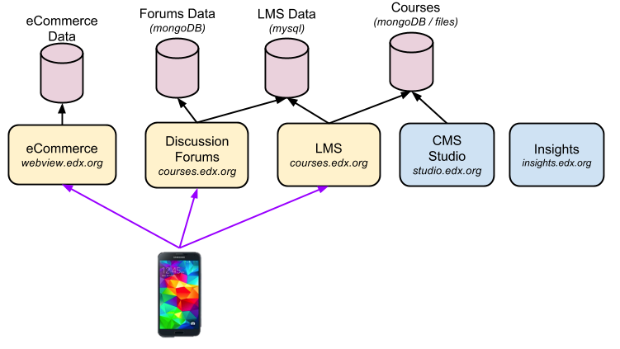
Mobile Connections

Slide 4
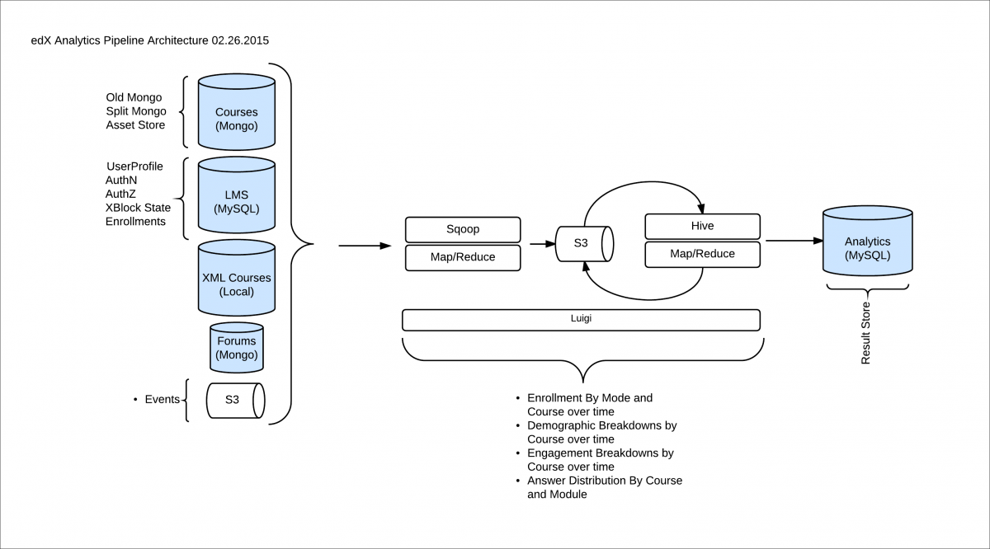

Slide 5
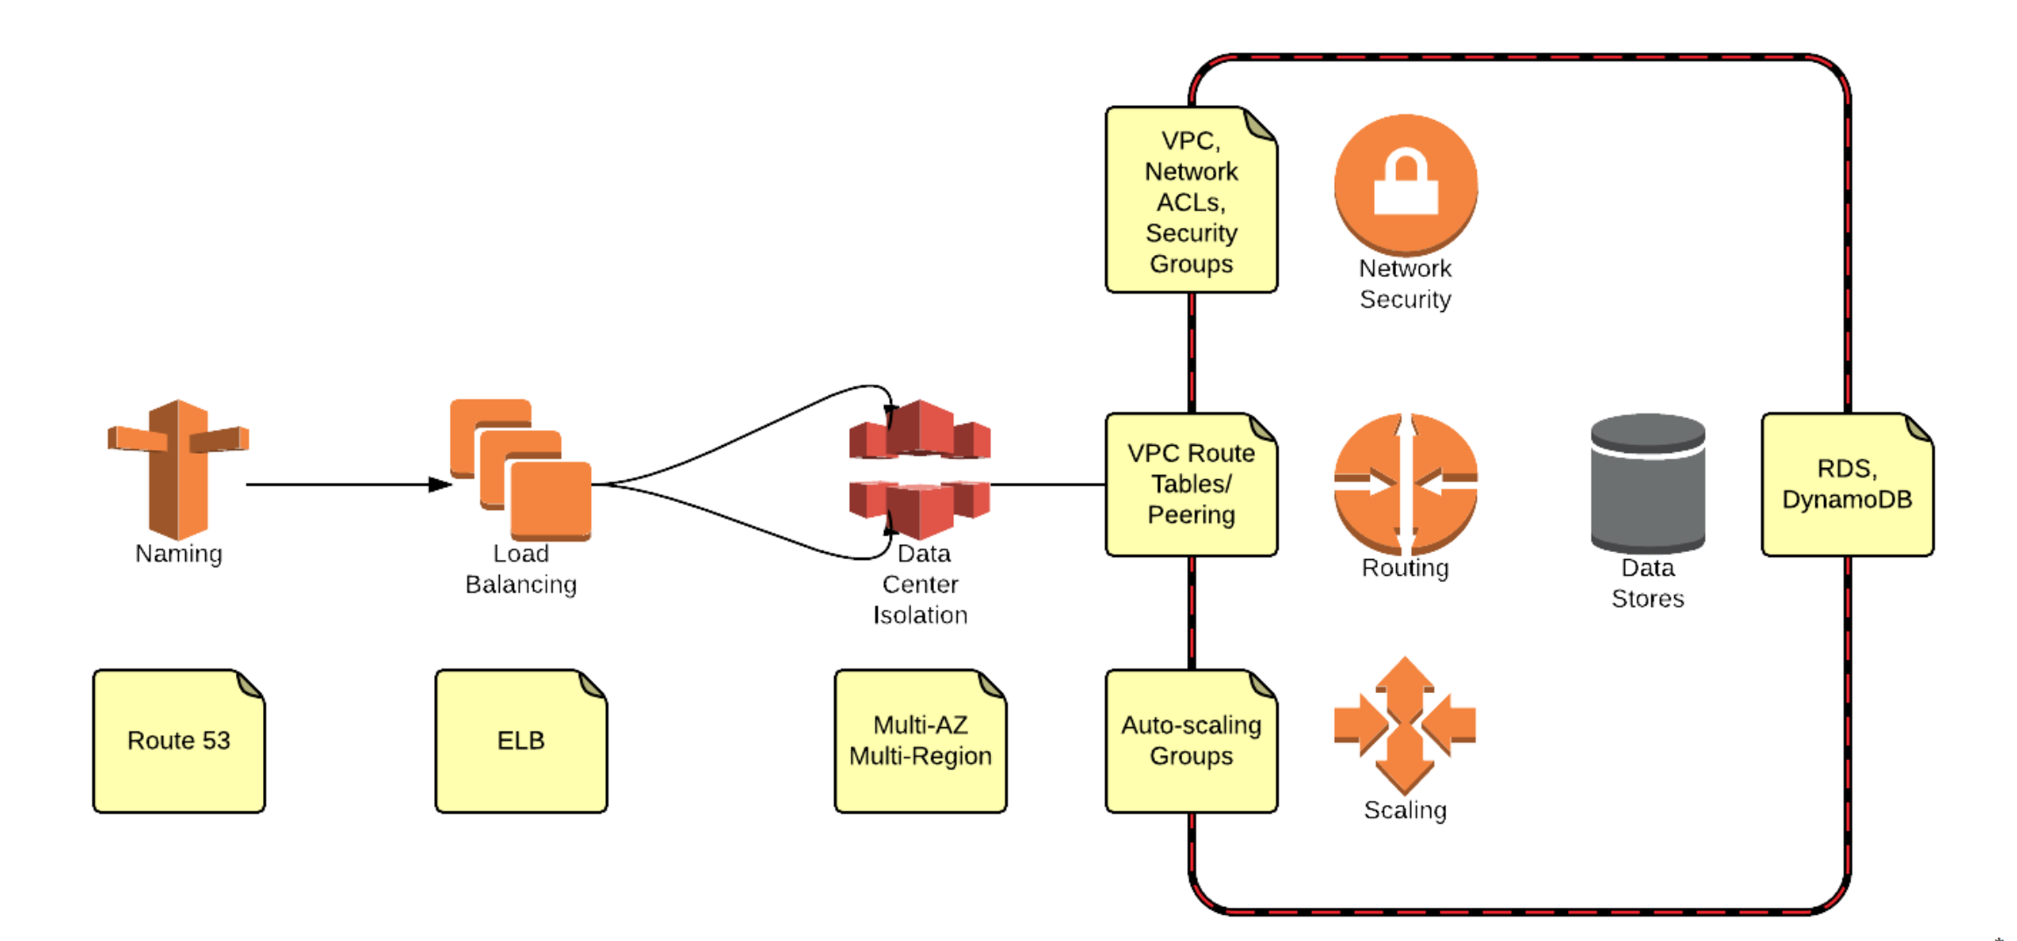

Slide 6
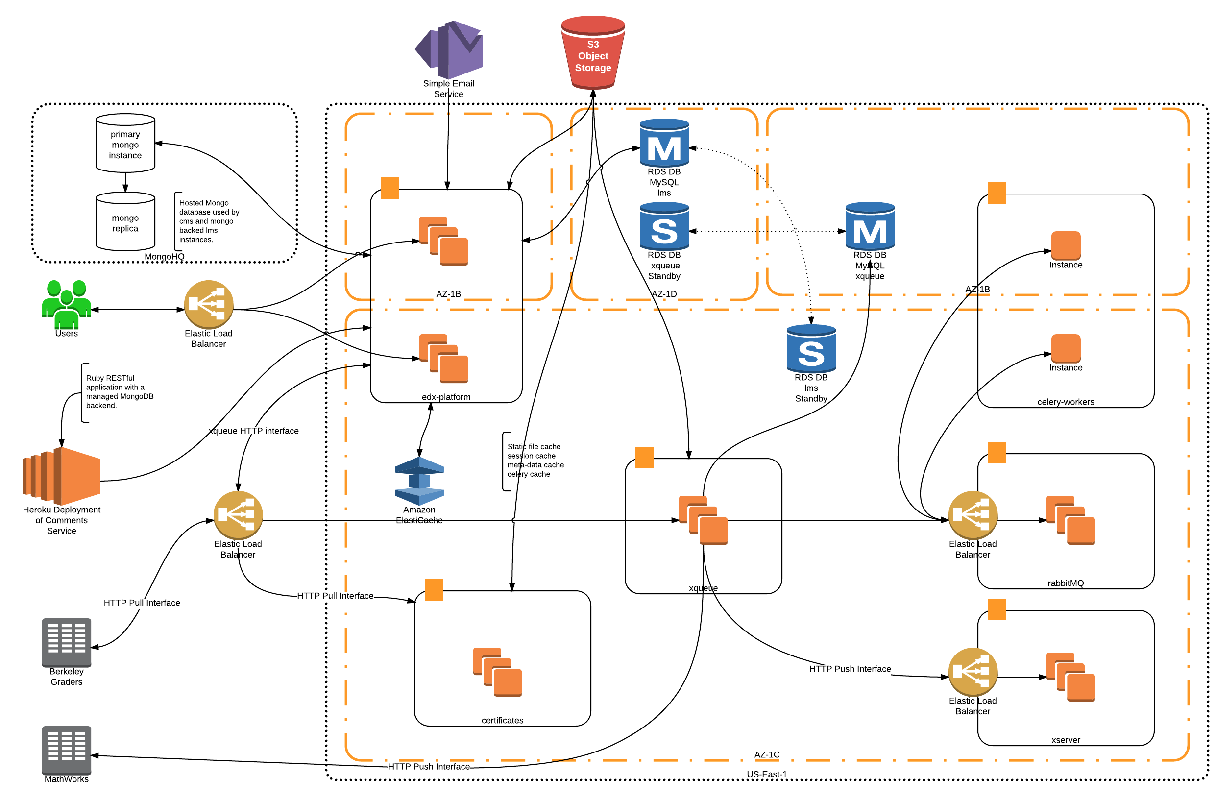

Slide 7
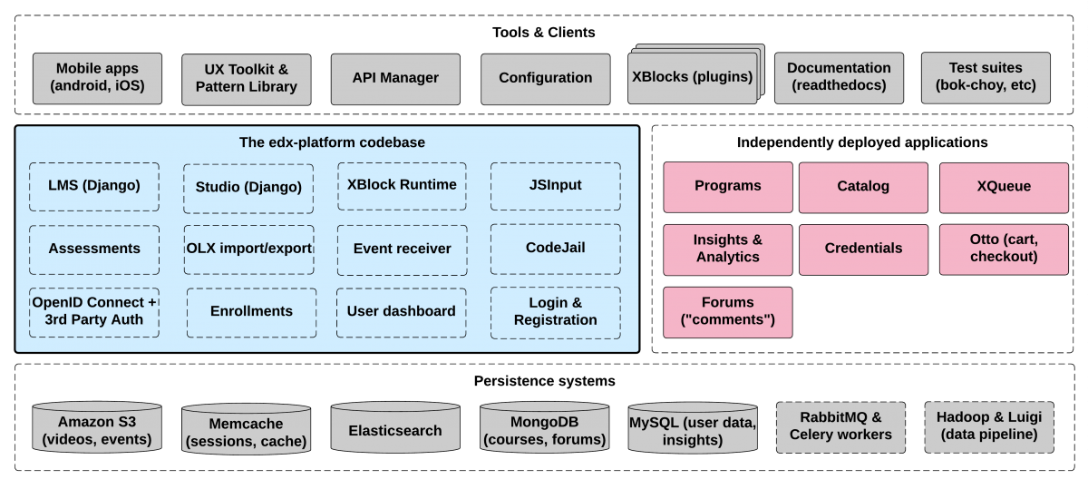

Slide 8
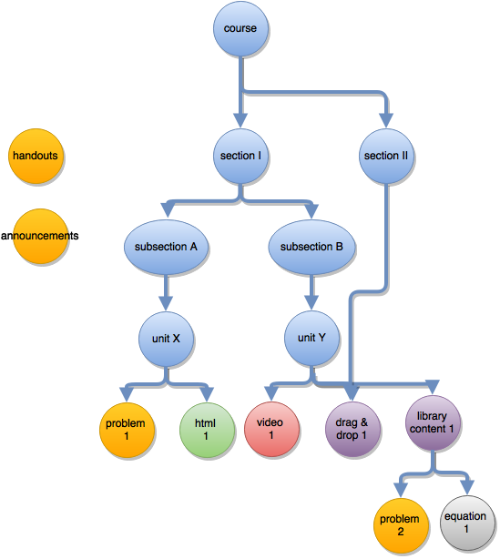
xBlocks

Slide 9
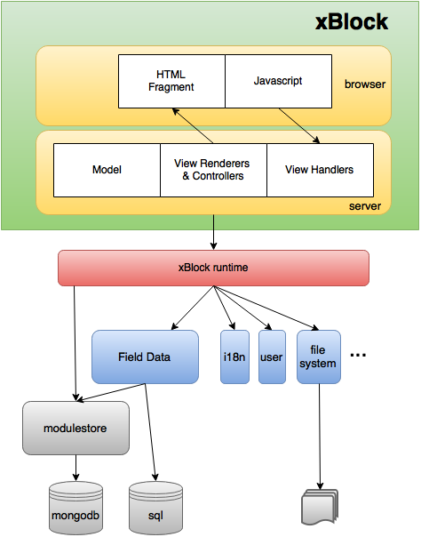
xBlocks

Slide 10
Server Environments
Devstack: localhost development and testing
Vagrant image running on local machine
Production
Running on AWS services maintained by devOps
Prod: Used by real live courses
Stage: Final test before Prod deploy with playable content
Edge – playground, some may be real courses
Sandbox: temporary server for dev and testing
Running on AWS services
Configurable, but not fully prod-like out of the box
Load: temporary for load testing

Slide 11
Coding Standards
Internationalization (i18n) / Localization (l10n)
Accessibility (a11y)
RTL (Right-to-Left)
REST API Conventions
Quality linters: PyLint, JSHint/ESHint/etc
Test Coverage
Security
Clean Code

Slide 12
Tools & Technology (1)
Languages:
Server-side: Python 2.7 (IDE: PyCharm)
Client-side: Javascript, HTML, CSS (Sass)
deprecated: Coffeescript
Web frameworks:
Server-side: Django 1.8.13
Client-side: Backbone, Underscore, RequireJS
Storage: MySQL, MongoDB, AWS
Search: Elastic Search
Docs: ReStructured text, sphinx

Slide 13
Tools & Technology (2)
Analytics
Processing Environment: Hadoop (EC2 & EMR), Luigi
Storage: HDFS (AWS S3) + Hive, MySQL, Vertica (Postgres DB) on EC2
Visualization: Google Analytics, Tableau, DataDog
Mobile
Android (Java) & iOS (Swift, ObjectiveC)
IDEs: Android DevStudio, Xcode
Build tools: Gradle

Slide 14
Testing
CI: Jenkins, Travis
Unit tests: Python unit tests
UI Unit tests: Jasmine (JS tests), Karma (runner)
Acceptance tests: Bokchoy
Including Accessibility tests
deprecated: Lettuce
Load tests:
Server-side: Locust.io
Client-side: sitespeed.io
Task management: paver, gulp (for JS)

Slide 15
Security
Goals
Confidentiality (who can read)
Integrity (who can edit)
Availability (prevent denial of service)
Authentication
Django Authentication classes
Session cookies (Web transactions)
OAuth bearer tokens (API transactions)
JWT tokens (server-server transactions for now)
deprecated: API Keys
Authorization
Django Permission classes
LMS: has_access
Server-side, can’t trust client

Slide 16
Security Attacks
XSS (Cross-site scripting)
Safe Templates Linter
CSRF (Cross-site request forgery)
Safe Endpoints Middleware
CSRF Middleware
exceptions: CORS (Cross-origin Resource Sharing)
Safe Sessions Middleware
Binds user to session cookie
Enforces cookie expiration

Slide 17
API Design
Authentication: OAuth2 access tokens using Bearer authentication scheme.
Authorization: Server-side access control checks for all data access.
Client/server division of labor
Business logic centralized on server
Pluses: Thinner clients and future maintainability
Minuses: Offline support is difficult
Performance:
Response Time: 95% response time < 2 seconds (at most)
Round Trips minimized. Tradeoffs between payload size, pre-fetching, and client-side caching of the data.
Payload Size minimized by parameterized APIs (filters, etc).
Favoring Generic APIs over Mobile-specific ones

Slide 18
Authentication 1st Party OAuth Login
App
LMS
oauth2/access_token grant_type=password
<edX Token>, <refresh Token>
API calls
Bearer = <edX Token>

Slide 19
Authentication 3rd Party OAuth Login
App
Google/FB
LMS
Login
<G/FB Token>
oauth2/exchange_token
<G/FB Token>
authorize, <G/FB Token>
success
<edX Token>, <refresh Token>
success
API calls
Bearer = <edX Token>

Slide 20
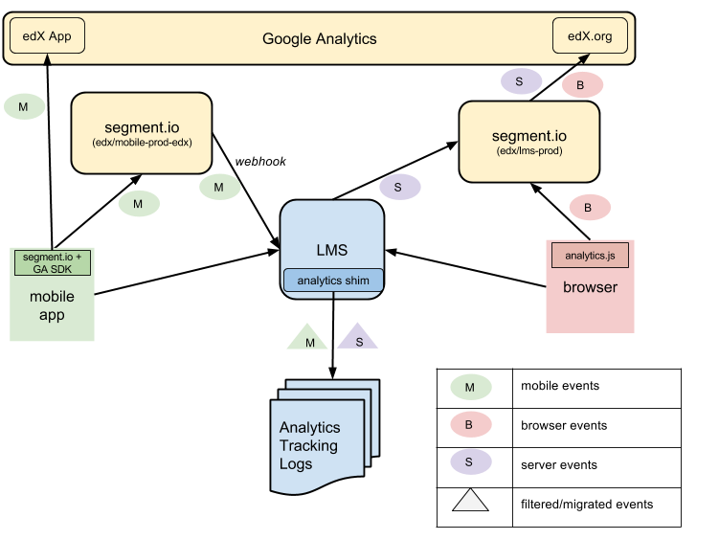
Analytics

Slide 21
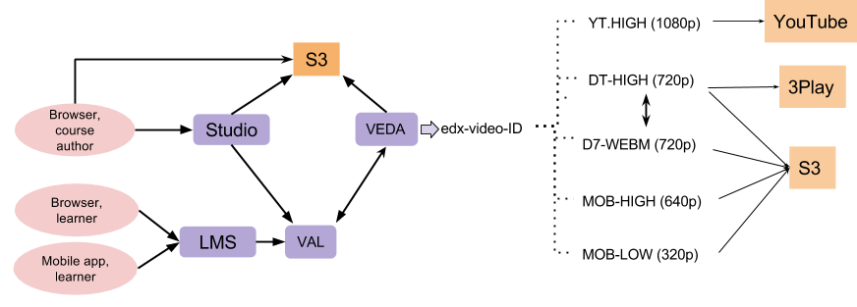
Video Pipeline

Slide 22
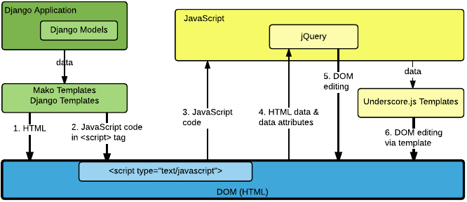
Django Front End

Slide 23
Monitoring
New Relic – performance and crash analysis
Google Analytics – usage analysis
Splunk – log analysis
Datadog – statistical analysis
Crashlytics (Fabric) – crash analysis of mobile apps
Analytics Pipeline (Vertica and Tableau)
Profiling: PyInstrument, RunSnakeRun

Slide 24
Performance & Scalability
Courses
Deep/broad hierarchy
Large assets
Many users
Videos
Resolution
CDNs
Fewer API calls versus smaller payloads
Caching
Client-side caching and pre-fetching
Server-side caching is tricky (ACLs, dynamic data)
Expiration (Expires/Cache-Control), Validation (Last Modified) Models

