Slide 1
Notes:
Plays while people come in

Slide 2
best Practices for Open edX Site Requirement Gathering
Kimberly Watson and Moritz Wilhelm Open edX Conference 2019
Notes:
Introductions

Slide 3
© Fast Lane 2019
Notes:
Moritz:
Walk through intro

Slide 4
Let’s BUILD A PLATFORM!!!
code
video
content
integrations
database
configuration
discussions
MOOC
domains
microsites
libraries
roadmaps
components
catalog
security
implementation
wikis
branding
Notes:
Kimberly:
Org or customer decides to build
Immediately, technical considerations and architecture/engineering springs to mind
*CLICK*
Great attention is given to functionality – what CAN we do; not so much on what SHOULD we do or what do we NEED
Goal of this presentation is to blend outcomes planning with technical planning to avoid backtracking, unnecessary missteps, and frankenprojects

Slide 5
Typical considerations
Conquer the World
Stop Climate Change
User experience
Branding
Integrations
Features
Hosting
Accessibility
Achieve World Peace
Declare Pluto a Planet
Infrastructure
Security
Technical Capabilities
Notes:
Moritz:
Typical system architecture considerations:
infrastructure/hosting,
integrations,
feature engineering
security
branding etc.
Not narrow down process to working through technical requirement spec
INSTEAD other way around
Provide frame/environment for product team to articulate realistic expectations/outcomes
Technical scoping as result of (joint) product outcome planning
Not fall into rubber stamp model, plan for range of flexibility (esp. when complex use case)
No close alignment between technical and product team = risks
delays
increasing cost
user satisfaction
Worst case: total failure
OUTCOME PLANNING IS CRUCIAL

Slide 6
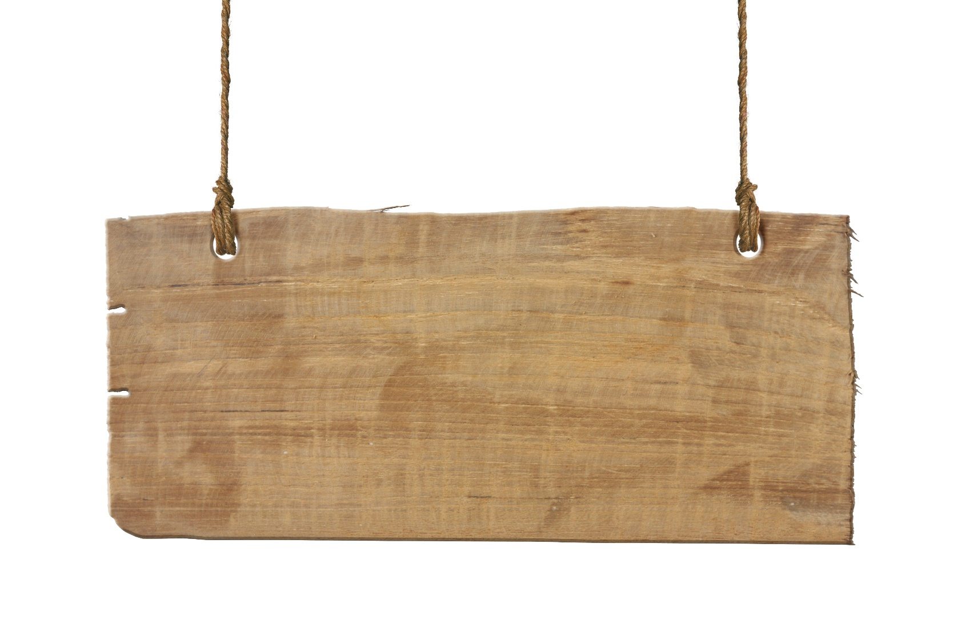
Outcome planning
MULTIPLE STAKEHOLDERS
Notes:
Kimberly:
How will outcome planning save us time and energy later? If you truly think about the scope of the project and the number of people and teams it will touch, you may be surprised at the ripple effects throughout your organization.
Often think of a single person or team as being the key stakeholder – examples engineer, project sponsor…
*CLICK*
Not only will it include the company sponsor(s) with the initial idea to create the platform and their target audience(s); it also affects the engineers, designers, developers, project management personnel, accounting, services, and technical support. ALL these people should be considered stakeholders, and all should be included at various stages throughout the process.
Moritz:
for all these stakeholders outcome planning
Clarifies product expectations
Avoids misunderstandings and wrong perceptions
Avoids constant change requests throughout the project
Enables meeting realistic deadlines
Overall it saves:
Time
Money
Nerves
*Parker, Van Alstyne, & Choudary (2016), Platform Revolution, W.W. Norton & Co., New York, NY.

Slide 7
Outcome planning
Participants + Value Unit + Filters = Core Interaction*
+ Value Unit + Filters = Core Interaction*
+ Value Unit + Filters = Core Interaction*
+ Value Unit + Filters = Core Interaction*
*Parker, Van Alstyne, & Choudary (2016), Platform Revolution, W.W. Norton & Co., New York, NY.
Notes:
Kimberly: #1 question – what do you want your users to DO or TAKE AWAY from the platform? *CLICK*
Knowledge?
Certifications?
Skill practice and growth?
That translates into what you intend your core interaction to be:
Participants + Value Unit + Filter → Core Interaction*
Moritz:
Core Interaction Definition is absolutely crucial.
Core interaction is the foundation of the product concept and will be
Translated into a workflow that will be powered by technology AND
rendered into the most compelling UX possible
*CLICK*
Participants:
What is your audience, both now, and in the future? How might the platform audience grow?
How do their needs differ, if at all?
Moritz:
Understanding your User Persona/User Profile is crucial to
Design compelling UX
Understand and plan for possible network effects (collaboration etc.)
Understand possible dimension of absolute users (infrastructure design impact)
Kimberly:
*CLICK*
Value Unit:
Are participants (and the platform initiators) after knowledge?
Skills practice?
Centralized location for services, such as scheduling online and live events?
Coaching and mentoring? Other?
Moritz:
Same here!
Definition of the Value Unit has direct impact on
UX
Configuration
Features
…
Most of you may immediately define “taking a course” as the value unit/core interaction
HOWEVER
There are different perceptions of what that means (on demand, passive/active etc.)
Required assets/interactions may completely vary (labs!, open assessments, group work etc.
Depending on the value unit you might be able to resolve it out of the box with Open edX or not (technology labs!)
Kimberly:
*CLICK*
Filter:
How will you create an environment that provides information to various groups or participants that is relevant and useful to them?
Useless information may turn users off from the platform, leading to reduced use and lack of perceived value
Moritz:
Again a similar scenario, ties in with value unit + audience persona.
Impacts set of tools and configurations needed
Too often, planners embrace a “build it and they will come” strategy, when platform engagement really benefits from a pull strategy of providing something of value and interest to participants to capture their attention and time.
Moritz:
Right!
Outcome can certainly not prepare for all variables and CRs due to fast paced environment
BUT defining your core equation (audience, value unit, core interaction) is the essential foundation for a professional outcome planning
STILL it leaves enough space for flexibilty
This fits better under core interaction I think. The value unit in most cases will be the learning assets while the interaction around it might be different, don’t you agree?

Slide 8
AUDIENCE IDENTIFICATION
HERE DO I TOIL
WE HELP WITH THE TOILING!
EMPLOYEEs
pARTNERS
cUSTOMERS
Notes:
Kimberly:
Participants – how do they affect architecture and planning?
What do you want your users to DO or TAKE AWAY from the platform?
Analyze current and future audience
May start with a small pilot group, for instance limited internal employees *CLICK*
Then may broaden to additional departments, or company-wide
Will partners eventually access the platform? *CLICK*
Customers? *CLICK*
Are there likely to be language considerations/internationalization required?
PLAN FOR GROWTH
Moritz:
How do the audience considerations affect architecture planning?
Audience size affects
Hosting / Infrastructure:
Platform architecture (single/multi-tenant) for high scalability
Hosting Location (on-prem, cloud options)
Audience type affects
Authentication and Security (!) -> IDP/SSO?
Free access / Paywall ?
Multisite set-up with Microsites ?
DNS, branding, marketing content
Filters and personalization

Slide 9
What is/ARE the platform’s value unit(s)?
Social networking
KNOWLEDGE
Convenient Access
Information Updates
SKILLS
PRACTICE
Notes:
Kimberly:
What is the value unit (or value proposition) for the platform?
What do you want your users to DO or TAKE AWAY from the platform?
Is the goal for users to become certified on a well-known vendor program or official curriculum of some sort (such as an internal company certification)?
Do you want your users to have access to a wider set of titles that relate to their area of specialty?
Will some content be gated, meaning that access is conditional?
PLAN FOR GROWTH
What types of content will be deployed – video hosting, SCORM-compliant media, live content, other?
Do your users value collaboration and social engagement?
Will the platform be integrated to other applications or systems currently in use in the environment in order to facilitate ease of use or seamless user interfaces?
What does the COMPANY get out of the platform?
Detailed user information and performance reporting?
User engagement via wikis, discussions, other feedback and social interaction?
Moritz:
Does platform need link to external cert/badging engine?
If so, which one(s), and what sort of partnership/integration is needed?
What external systems need to be integrated and what value do these add?
Benefits & Concerns
E-Commerce, IDP, LMS, CRM, Analytics etc.
Will all content be designed with std. studio features?
or will you need scalable media hosting, integrations with LTI/SCORM etc.?
Will reporting be a crucial part of the value unit?
If so, how will you fetch and visualize the data (Data WH, BI Tools etc.)

Slide 10
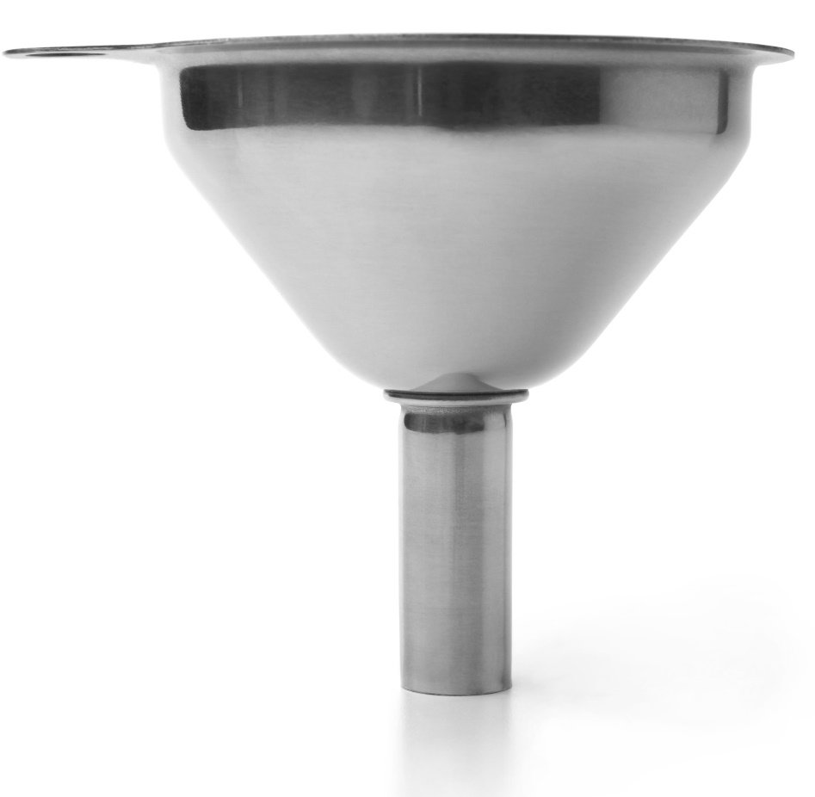
WHAT FILTERS ARE NEEDED?
Notes:
Kimberly:
How will you create an environment that provides information to various groups or participants that is relevant and useful to them?
The type of filters needed for a deployment largely depend on the audience(s) you’re planning to engage on the platform and the OUTCOMES you want to see from your group(s)
We’ve looked at audience planning and segmentation to some degree, yet these considerations carry through to technical integrations as well
A search function is generally a good idea, but how detailed should it be? Titles only, descriptions, etc.?
Should you provide access to various audiences through RBAC, separate microsites, or some hybrid of the two? Do you have plans to utilize the cohort feature to keep audiences organized? Deciding questions such as this from the outset can alleviate conflict later; if a cohort management strategy is sufficient, do you need to take the time and effort to create an RBAC policy?
Will you utilize tools such as gating assessments – online exams that require you pass prior to accessing content – or course pre-requisites? Are these items required of all audiences?
Moritz:
How will you create an environment that provides information to various groups or participants that is relevant and useful to them?
Want to enable highly individualized and fast search within large catalogue?
May need custom attributes, search interface, powerful search backend
What segmentation options should and can be employed?
Microsites, RBAC, learning paths, programs, cohorts etc.
Native vs. non native!
Security/Authentication may handle information security between audiences
But prepare for those audiences that may not be coming from a linked system

Slide 11
MAINTENANCE AND UPKEEP
?
Notes:
Kimberly:
Great – now you have your building considerations laid out so you can begin designing your platform!
We won’t go into the implementation phase – you’re getting plenty of great information and advice here at the conference
So you planned and built this magnificent beast of a platform that does exactly what you want it to do – yippee!
NOW WHAT???
Think about your plans for post-deployment maintenance EARLY in the planning stages
Do you have, or do you plan to bring in, your own engineering team to maintain the infrastructure, attend to ongoing hosting, and provide technical support?
Do you have, or do you plan to bring in, your own instructional design and development team to create and manage courses on the platform?
If your answer to these questions is NO, consider outsourcing – there are plenty of great companies available to help you with this (of which we’re one, of course)
If your answer to one or both questions is YES, plan ahead!
There is a LOT to master in the engineering background, so find people you trust to grow with you as your implementation becomes a reality – that way they will understand how and why your system evolves the way it does
Instructional designers and MOOC developers are not very common – there are a lot of people who can figure out the uploading and creation side of edX Studio, but as with any specialty, fewer who can design tactically to maximize user engagement, employ a subset of the available tools of edX to achieve specific learning goals, etc.
A great place to start is on openedx.org by taking the edX Course Creator Professional Certificate
This is NOT the same as having qualified instructional designers available to you, but it will teach instructional designers the basics of creating online MOOC courseware
If you haven’t already joined, you should also hook up on openedx.slack.com – great online community for both technical answers and pedagogical conversation
Moritz:
Definitely one of the most important areas to prepare for.
Let’s consider you get the heavy lifting and set-up done by an engineering partner
THEN WHAT?
Who will maintain the infrastructure (if application runs on your own cloud)?
Who will run platform operations/administration?
Who will provide technical support to users, staff etc.?
Who will provide customer support?
Who will continue engineering your platform?
Who will spin up subsites or do additional deployments?
Do you want to outsource everything or start building in-house knowledge?
Depending on platform relevance you should def. start building expertise and process, primarily around:
Features (LMS and Studio)
Administration (Catalogue, ..)
Customer Support
.. to be able to support your audience in the best way possible since you know them best!
Investment into in-house internal technical expertise should be well evaluated and aligned with desired outcome (Scalability? Security? Just saving costs).

Slide 12
Let’s BUILD A PLATFORM!!!
DESIGN
Notes:
Kimberly:
Definition of an engineer: Somebody who makes precise guesswork based on unreliable data provided by people with questionable knowledge
We’ve tried to provide you some questions to help you avoid this scenario, which is all too common ☺
Rather than dive in from the get-go and BUILD a platform, I hope we’ve given you some useful information to help you take a breath at the beginning and pay close attention to PLANNING a platform
Remember that your number one concern should be your end result – what outcome are you or your customer looking to achieve by building and utilizing a platform?
You may know some of these planning considerations already, as well as your platform needs; however, remembering to address each of these considerations as you gather your site requirements will ensure specificity in your build process, and may lead to additional considerations or concerns that you may not otherwise have addressed.
Moritz:
Wrap up and fill in
Final thoughts and thank you!
Intro questions

Slide 13
QUESTIONS?
And hopefully answers…

Slide 14
Contact us
WORLDWIDE CONTACT INFORMATION
Kimberly.Watson@fastlaneus.com
Moritz.Wilhelm@fastlane.net
www.fastlaneus.com www.fastlane.net
1.855.778.7246

